Slide 1

Company Law Examination Revision – Session 2
Neill McWilliams MSc, MBA, FCG
neill@kcb.ac.uk
Kcbglobal.net
In association with

Slide 2
Agenda
The board of directors
Overview of knowledge
Questions
Examination practice
Questions
Directors’ duties
Overview of knowledge
Questions
Examination practice
Questions

Slide 3
Schedule of Sessions
Session 1: Business Structures
Constitution and legally binding the company
Session 2: The board of directors
Directors’ duties
Session 3: Membership
Members’ remedies
Session 4: Shares and share capital
  Liquidation & dissolution

Slide 4
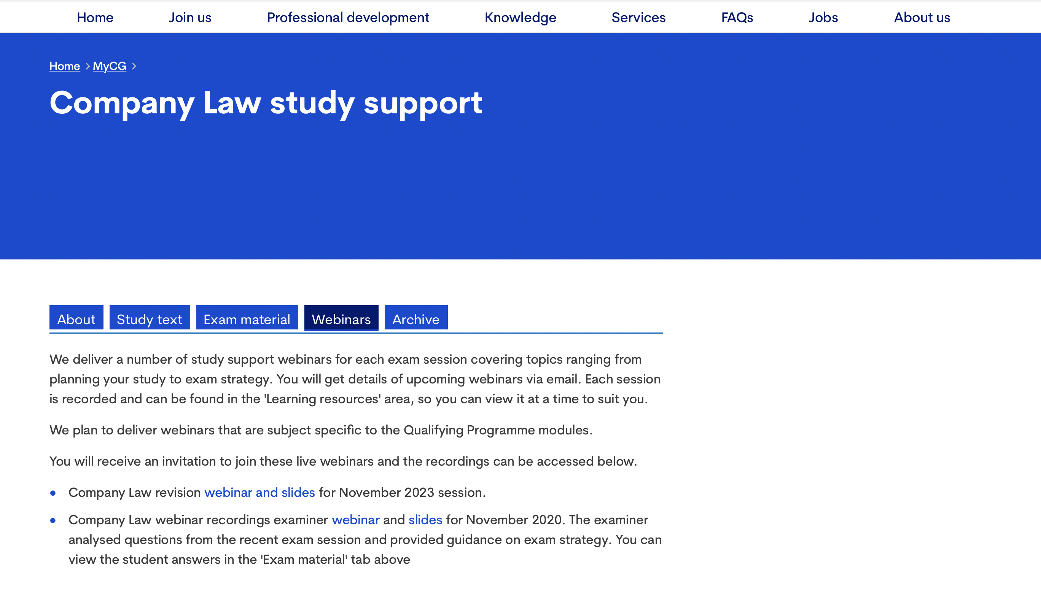
MyCG
https://www.cgi.org.uk/my_cg/qualifying-programme-part-1-2

Slide 5

KCGglobal.net

Slide 6
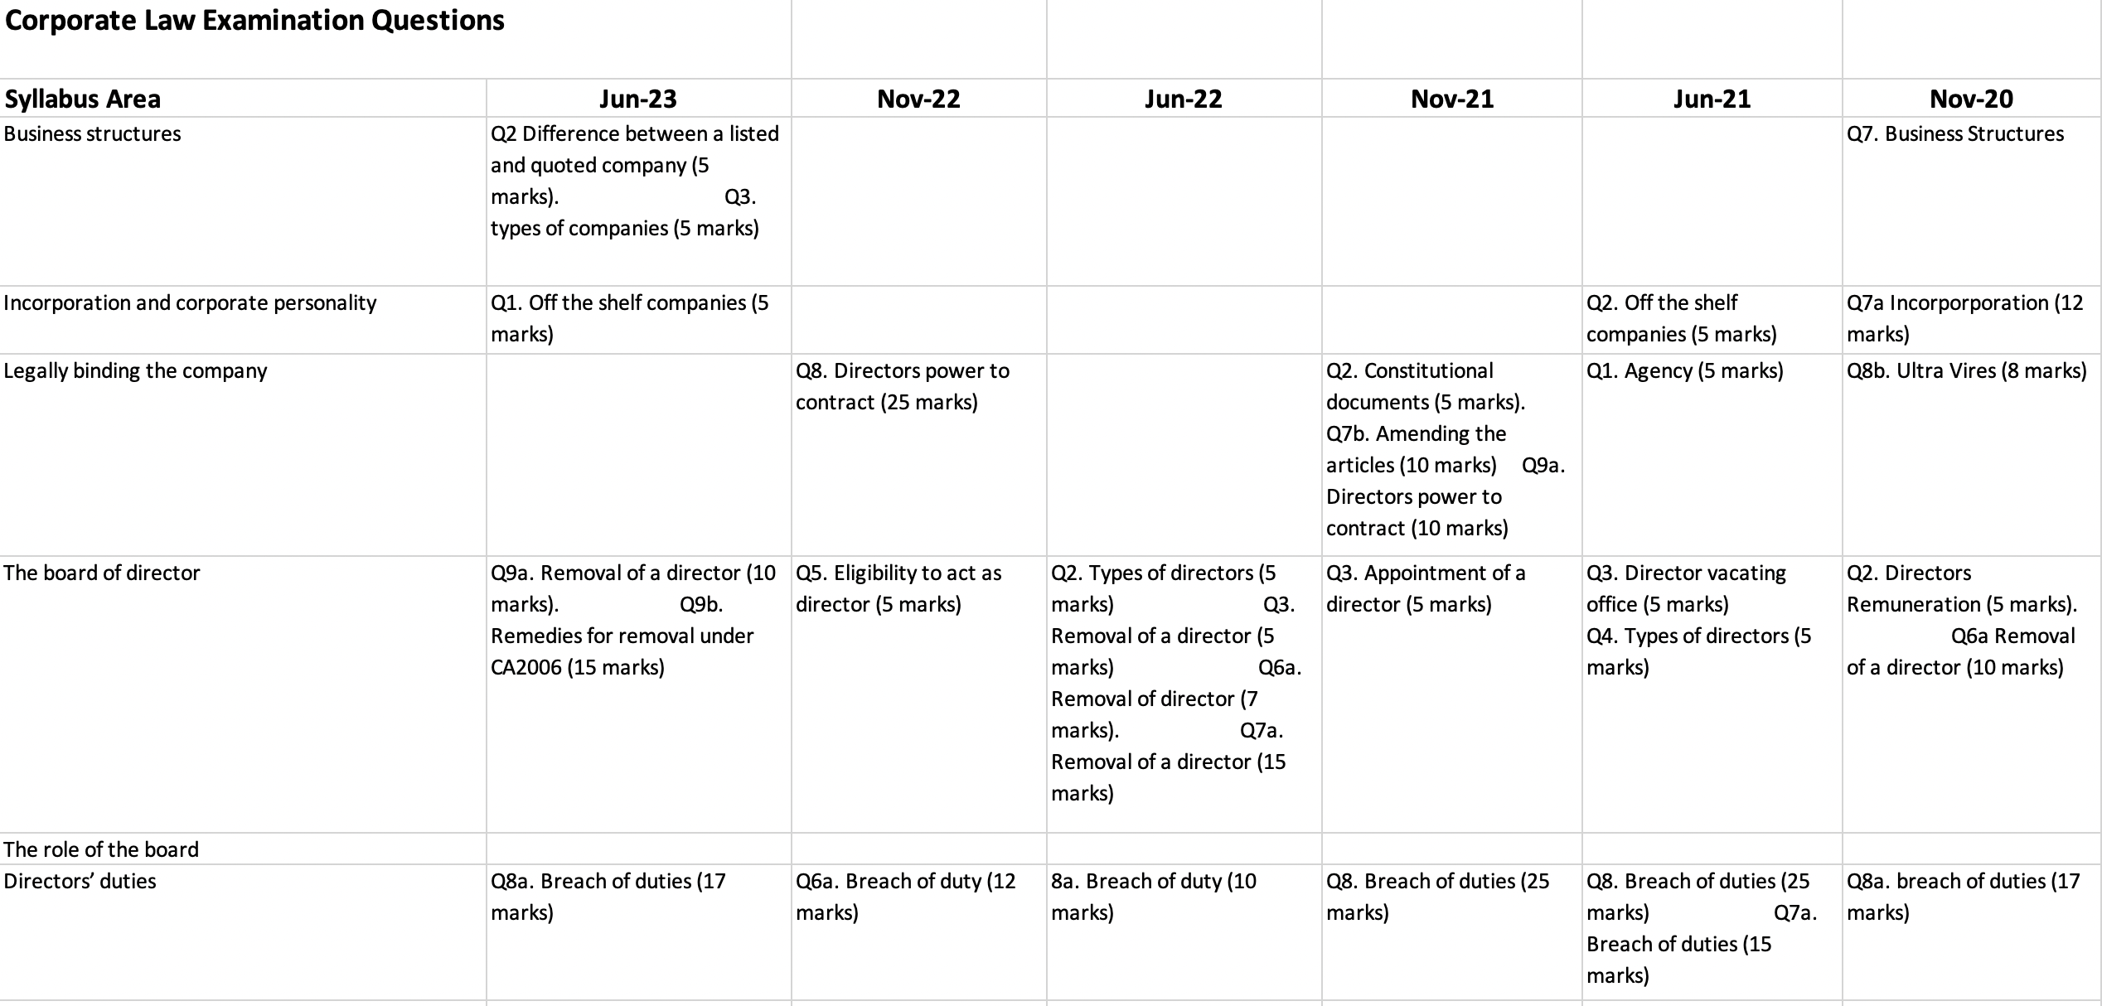
Examination Question Matrix

Slide 7
The board of directors
The board of directors

Slide 8
Agenda
What is a director?
The appointment of directors
Directors’ remuneration
Board structure and composition
Vacation of office

Slide 9
What is a director?
‘Any person occupying the position of director, by whatever name called’ (CA 2006, s. 250)
Companies required to have at least one director who is a natural person.
This requirement is met if the office of director is held by a natural person as a corporation sole or otherwise by virtue of an office.
A White Paper published in February 2022 (BEIS, Corporate Transparency and Register Reform White Paper (2022)) states that a company can be appointed as a director if (i) all of its directors are natural persons, and; (ii) those natural persons had, prior to the corporate director’s appointment, been subject to the proposed Companies House identity verification process. This exception will only apply to UK legal entities and not overseas entities.
Proposal to prohibit corporate directors (CA2006 156A)
Notes:
Someone called a director who is not and someone not call a director who is.

Slide 10
Types of directors
A de jure director is a person who has been validly appointed as a director
A de facto director is a person who acts as a director but has not been validly appointed, sometimes referred to as a ‘shadow director’
‘A person who effectively controls the activities of a company is to be subject to the same statutory liabilities and disabilities as a person who is a de jure director’ – Ultraframe (UK) Ltd v Fielding [2005]
The Director Test
Exercise real influence (otherwise than as a professional adviser) in the corporate governance of the company (Re Kaytech International plc [1999]– simply being involved in management or influencing decision making is not enough (Popely v Popely [2019]
Undertake functions which could properly be discharged only by a director (Re Hydrodam (Corby) Ltd [1994]
Participate in directing the affairs of the company and act on an equal footing with the de jure directors (Secretary of State for Trade and Industry v Hollier [2006]
Notes:
NOT a Director
giving advice in a professional capacity;
– giving instructions, directions, guidance or advice in the exercise of a function conferred under an enactment; or
– giving guidance or advice in a capacity as a Minister of the Crown

Slide 11

UK Corporate Governance Code
Developed through successive reports and codes since 1992
Forms part of the Listing Rules, for companies with a premium listing
Adhered to using a ‘Comply or Explain’ basis

Slide 12
Executive and Non-Executive Directors
Company law does not distinguish between executive directors and non-executive directors (NEDs)
An executive director is usually a full-time employee of the company and will be involved in the day-to-day management of the company.
A NED is not usually an employee of the company, is part-time (usually around one to two days per month), and their managerial role is much more limited.
NEDs have an additional role, namely to ‘scrutinise and hold to account the performance of management and individual directors against agreed performance objectives’ (UK Corporate Governance Code, Provision 13).
The Board
Executive
Director
Non-Executive
Director
Independent
Non
Independent

Slide 13
Independent Non Executive Directors
For companies with a premium listing, at least half the board, excluding the Chair, should be made up of NEDs whom the board considers to be independent (UK Corporate Governance Code, Provision 11).
Independence Test
Is or has been an employee of the company or group within the last five years;
Has, or has had within the last three years, a material business relationship with the company, either directly or as a partner, shareholder, director or senior employee of a body that has such a relationship with the company;
Has received or receives additional remuneration from the company apart from a director’s fee, participates in the company’s share option or a performance-related pay scheme, or is a member of the company’s pension scheme;
Has close family ties with any of the company’s advisers, directors or senior employees;
Holds cross-directorships or has significant links with other directors through involvement in other companies or bodies;
Represents a significant shareholder; or
Has served on the board for more than nine years from the date of their first appointment.
The Board
Executive
Director
Non-Executive
Director
Independent
Non
Independent

Slide 14
‘Other’ types of Director
Alternate directors
Appointed to act on another directors behalf, if it is provided for in the company’s articles.
Nominee directors
Someone with an interest in the company (such as a major shareholder or creditor) may wish to safeguard their interest by having a say on the board.
This power of appointment will usually be placed in the company’s articles, but could also be set out in a shareholders’ agreement.
A nominee’s duty is to the company, not the person who appointed him (Scottish Co-Operative Wholesale Society Ltd v Meyer [1959] AC 324 (HL)).
A person who appoints a nominee could be regarded as a person with significant control, and so will have to be identified on the PSC register.
Notes:
The CA 2006 does not empower a director to appoint an alternate, so a director will only have such a power if it is provided for in the company’s articles.
The model articles for private companies do not contain such a power, but article 25(1)
of the model articles for public companies does provide that a director (known as ‘the appointer’) may appoint another director, or any other person approved by a resolution of the directors, to exercise the appointer’s powers and carry
out the appointer’s responsibilities. The articles will set out what the alternate director can and cannot do, and the circumstances under which his appointment will be terminated.

Slide 15
Specific board roles of directors
A director may be appointed to a specific board role.
The role and powers of specific board roles are a matter for the company’s articles
The CEO is the head of the company with the providing that ‘[a]s the most senior executive director, the chief executive is responsible for delivering the strategy as agreed by the board’ (para 70, FRC Guidance on Board Effectiveness).
The directors may appoint a director to chair their meetings who ‘leads the board and is responsible for its overall effectiveness in directing the company’. (Principle F, UKCG Code)
‘The roles of CEO and Chair should not be exercised by the same person.’ (Provision 9, UKCG Code)

Slide 16
The appointment of directors
Persons are not eligible to act as a director
A person under the age of 16 (CA 2006, s. 157)
A company’s statutory auditor (CA 2006, s. 1214)
A person subject to a disqualification order/undertaking CDDA 1986, s. 11(1))
An undischarged bankrupt (CDDA 1986, s. 11(1))
A company’s articles may also contain provisions that prohibit or limit a person’s ability to act as director
Notes:
The CA 2006 says very little about the appointment of a director, preferring to leave the appointment process for companies to determine themselves via their articles. Before looking at this process, it is important to note that statute does state that
The CA 2006 says very little about the appointment of a director, preferring to leave the appointment process for companies to determine themselves via their articles. Before looking at this process, it is important to note that statute does state that

Slide 17
The appointment of directors
First directors will be appointed upon the company’s incorporation (CA 2006, s. 16(6)).
Further appointments are a matter for the company’s articles.
‘Appointments to the board should be subject to a formal, rigorous and transparent procedure’. (Principle J, UKCG Code)
The board should establish a nomination committee, whose role is ‘to lead the process for appointments, ensure plans are in place for orderly succession to both the board and senior management positions, and oversee the development of a diverse pipeline for succession’. (Provision 17, UKCG Code)
Notes:
If the company’s articles say nothing about the appointment of directors, then the model articles will apply and provide that a director can be appointed by an ordinary resolution or by a decision of the directors (model articles for private companies, article 17(1); model articles for public companies, article 20). If such a company has excluded the model articles, then the power to appoint a director is exercised by the members passing an ordinary resolution (Worcester Corsetry Ltd v Witting [1936] Ch 640 (CA)).

Slide 18
The register of directors
Every company must keep a register of directors (CA 2006, s. 162(1)) but a private company may, instead elect to keep the required information on the public register maintained by Companies House (ss. 167A–167E).
The register can be inspected by any member without charge, and by any other person upon payment of a fee (s. 162(5)).
When a new director is appointed, the company must notify Companies House of the appointment within 14 days. (Form AP01)
The notice to CH must contain a statement of the particulars relating to the director that will be included in the register of directors; and a statement by the company that the director has consented to act as director (s.167(1)–(2)).
Notes:
which contains specified particulars regarding each director (ss. 162(2), 163, 164 and 166).
In light of the government’s proposed reforms relating to the verification of a director’s identity, the government has proposed that the requirement placed upon companies to keep their own register of directors should be abolished. Following a consultation on this, the government’s White Paper states that the government is considering whether to change the requirement for companies to keep a register of directors (BEIS, Corporate Transparency and Register Reform White Paper (2022) 96).

Slide 19
Defective appointments
Possible that a director’s appointment may not be conducted in accordance with the articles.
This gives rise to the question whether a defective appointment invalidates the actions of that director
Acts of a person acting as a director are valid notwithstanding that it is afterwards discovered:
  that there was a defect in their appointment;
  that they were disqualified from holding office;
  that they had ceased to hold office; or
  that they were not entitled to vote on the matter in question.
s. 161(1) of the CA 2006

Slide 20
Board structure and composition
Board structure and size
UK companies tend to adopt a unitary board structure.
‘A private company must have at least one director, and a public company must have at least two directors.’ (s.154 CA 2006)
Board
Nominations Committee
Remuneration Committee
Audit Committee
Risk Committee
Notes:
The CA 2006 has little to say regarding a board’s structure and composition, meaning that the topic of board structure and composition is largely based on commercial and governance needs, as opposed to complying with legal obligations. As a result, the Corporate Governance module will discuss board structure and composition in more detail, but it is worth discussing some basic issues here.

Slide 21
Board structure and composition
Board composition and Diversity
Board appointments should ‘promote diversity of gender, social and ethnic backgrounds, cognitive and personal strengths’. (Principle J, UKCG Code)
A 2010 report entitled Women on Boards recommended that women should account for at least 25% of directors on FTSE 100 boards by the end of 2015.
The Hampton-Alexander Review went on to recommend that FTSE 350 companies should aim for at least 33% female board representation by the end of 2020. This figure was also reached.
The FTSE Women Leaders Review now recommends that FTSE 350 companies should aim for a minimum of 40% women representation by the end of 2025.
The Parker Review recommends that each FTSE 100 board should have at least one director of colour by 2021, and each FTSE 250 board should have at least one director of colour by 2024.
Nominations Committee

Slide 22
Directors’ remuneration
Remuneration Committee
The model articles provide that the directors themselves can determine their remuneration for their services to the company as directors, and for any other service which they undertake to the company (model articles for private companies, article 19(2); model articles for public companies, article 23(2)).
Remuneration policies and practices should be designed to support strategy and promote long-term sustainable success. Executive remuneration should be aligned to company purpose and values and be clearly linked to the successful delivery of the company’s long-term strategy. (Principle P, UKCG Code)
A formal and transparent procedure for developing policy on executive remuneration and determining director and senior management remuneration should be established. No director should be involved in deciding their own remuneration outcome. (Principle Q, UKCG Code)
Directors should exercise independent judgement and discretion when authorising remuneration outcomes, taking account of company and individual performance, and wider circumstances. (Principle R, UKCG Code)

Slide 23
Directors’ remuneration
Disclosure
Legislation provides that all large and medium-sized companies must disclose:
  the aggregate amount of remuneration paid to the directors;
  the aggregate amount of gains made by directors on the exercise of share options;
  the aggregate amount of money paid or assets received under a long-term incentive scheme; and
  the aggregate value of company contributions paid into directors’ pension schemes.
  details regarding the pay of its highest paid director;
  details regarding retirement benefits paid to directors and past directors;
  details regarding payments made to directors for loss of office; and
  details regarding sums paid to third parties in respect of directors’ services.
  (Schedule 5, Large and Medium-Sized Companies and Groups (Accounts and Reports) Regulations 2008 (SI 2008/410)
Notes:
Quoted companies must prepare a remuneration report, which contains extensive details regarding the directors’ remuneration. This report forms part of the company’s annual report and so is discussed more in Chapter 14.
Finally, companies whose securities are listed must disclose additional remuneration-related information (e.g. details of any long-term incentive schemes) in order to comply with the Listing Rules (LR 9.8.4). Companies with a premium listing will also need to comply or explain against the disclosure-related Principles and Provisions in the UK Corporate Governance Code.

Slide 24
Vacation of office
Vacation
A director can vacate office at any time by resigning and the company must accept his resignation.
A company’s articles may specify when a director is to vacate office. For example, the model articles (article 18 for private companies; article 22 for public companies) provide that a director will vacate office if:
  they cease to be a director by virtue of any provision of the CA 2006 or are prohibited from being a director by law;
  a bankruptcy order is made against them; or
  a registered medical practitioner who is treating that person gives a written opinion to the company stating that that person has become physically or mentally incapable of acting as a director and may remain so for more than three months.
Notes:
The general rule is that a resigning director vacates office as soon as he notifies the company of his resignation (OBC Caspian Ltd v Thorp (1998) SLT 653), but it is common for a period of notice to be specified in the director’s service contract. If the service contact provides for no notice period, a requirement to provide reasonable notice will be implied into the contract (CMS Dolphin Ltd v Simonet [2002] BCC 600 (Ch)).

Slide 25
Vacation of office
Retirement and Re-election
Articles may have a provision requiring retirement by rotation, which occurs where a director is required to periodically vacate office and, if they so wish, seek re-election.
Directors are subject to annual re-election. (Provision 18 of the UKCG Code)
Notes:
The CA 2006 does not require retirement by rotation, but a company’s articles may.

Slide 26
Vacation of office
Removal
A company may by ordinary resolution at a meeting remove a director before the expiration of his period of office, notwithstanding anything in any agreement between it and him’. (s.168(1) CA 2006)
The following rules must be complied with for the removal to be valid.
As s. 168(1) specifies that the resolution take place at a meeting, the written resolution procedure cannot be used (CA 2006, s. 288(2)(a)).
Special notice is required of a s. 168 resolution (s. 168(2)), namely 28 days (s. 312(1)).
A copy of the resolution must be sent to the director(s) whose removal is sought (s. 169(1)).
The director whose removal is sought has the right to protest against his removal and, to that end, may address the meeting (s. 169(2)) and circulate written representations to the meeting (s. 169(3)–(5)).
While s. 168 allows a company to remove a director, it will not deprive the director that has been removed of any compensation payable as a result of the removal (s. 168(5)(a)).

Slide 27
Vacation of office
Removal under the articles
Companies may insert a provision in the articles stating that a director will be required to vacate office if all the other directors so require.
A consequence of removing a director via such an article provision is that it need not comply with the procedural rules found in s. 168 (Browne v Panga Pty Ltd (1995) 120 FLR 34 (Federal Court of Australia)).

Slide 28
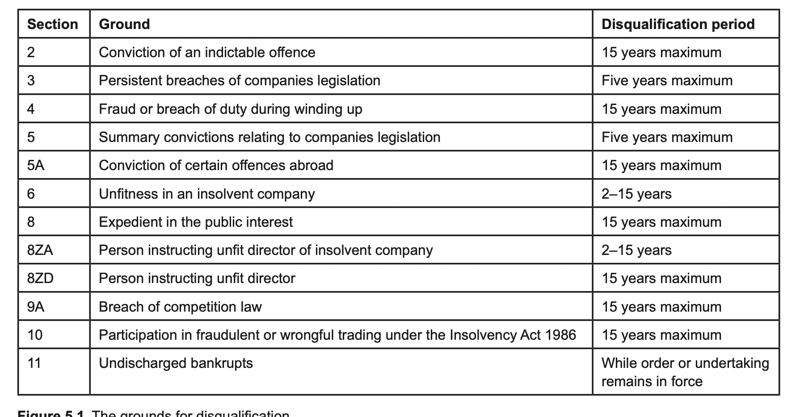
Vacation of Office
Disqualification

Slide 29
Questions?
Visit: www.cgi.org.uk
Kcbglobal.net
Linkedin: KCBGlobal
In association with

Slide 30
Examination Question
Describe the process for removal of a director under s.168 Companies Act 2006. (5 marks)
Q3, Jun22
Section 168(1) allows the company to remove a director (or directors) by passing an ordinary resolution at a meeting. The process is as follows:
The resolution must be passed at a meeting (1) (written resolution procedure cannot be used, nor can the unanimous assent procedure).
Special notice of 28 days is required. (1)
A copy of the resolution must be sent to the director whose removal is sought. (1)
The director has the right to protest, so may address the meeting (1) and circulate written representations. (1)
An ordinary resolution is required. (1)

Slide 31
Examination Question
Explain the difference between de jure, de facto and shadow directors. (5 marks)
Q2, Jun22
A de jure director is a person who has been validly appointed as a director in accordance with the articles and Companies Act 2006 (1).
A de facto director has not been validly appointed (1) but acts as a director nonetheless (1).
A shadow director is “a person in accordance with whose directions or instructions the directors are accustomed to act” (s.251(1) CA 2006) (1).

Slide 32
Directors’ duties

Slide 33
Agenda
The general duties
Avoiding liability
Transactions requiring member approval
Notes:
A significant amount of power is concentrated in the directors, and there is a danger that the directors will use this power in a way that benefits themselves (often at the company’s expense). One of the principal ways that such conduct is discouraged is by subjecting directors to a range of general duties, as well as requiring member approval for certain transactions involving directors.

Slide 34
The general duties
The CA 2006, partially codified directors’ in (ss. 170–187)
Referred to as ‘the general duties’, stating that these duties are ‘based on certain common law rules and equitable principles as they apply in relation to directors and have effect in place of those rules and principles as regards the duties owed to a company by a director’. (s. 170(3))
‘regard shall be had to the corresponding common law rules and equitable principles in interpreting and applying the general duties’. s. 170(4)
This lack of complete codification also applies to the remedies for breach of duty.
CA 2006 merely stating that the consequences of breaching the general duties ‘are the same as would apply if the corresponding common law rule or equitable principle applied’. (178(1))
Notes:
Previously the law relating to directors’ duties was primarily found in case law spanning back over 150 years. To improve accessibility and to bring certain duties up to date, it was decided that the law relating to directors’ duties would be partially

Slide 35
Scope of duties
In determining the scope of the general duties, two questions must be answered.
  To whom are the general duties owed?
  To whom do the general duties apply?
Section 170(1) states that the general duties are owed by a director of a company to the company, meaning that:
  the directors do not owe their general duties to other persons (e.g. the members, employees, creditors etc.); and
  the only persons who can commence proceedings for breach of duty are the company itself and those persons who are empowered to bring claims on the company’s behalf (e.g. the directors, the members via derivative claim).
  The duties can also apply to former directors of a company (ss. 175 and 176)

Slide 36
Duty to act within powers (s171)
Imposes two duties upon directors:
  a duty to act in accordance with the company’s constitution; and
  a duty to only exercise powers for the purposes for which they are conferred.

Slide 37
Duty to act within powers (s171)
Duty to act in accordance with the constitution
The constitution may place limits upon the directors’ powers.
If a director breaches the constitution, any contracts resulting from it will remain valid, but the director will be in breach of their s. 171(a) duty.
A director in breach will be required to account for any gains made, or compensate the company for any losses it sustained, as a result of the breach.

Slide 38
Duty to act within powers (s171)
Duty to exercise powers for the purposes for which they are conferred
Test involves four steps:
The court will determine what power is being exercised. Bulk of the case law relates to the directors’ power to allot shares on behalf of the company. Extrasure Travel Insurances Ltd v Scattergood [2003] 1 BCLC 598 (Ch),
The court will determine the proper purpose for which that power was delegated to the directors, (Howard Smith Ltd v Ampol Petroleum Ltd [1974] AC 821 (PC)).
The court will determine the substantial purpose for which the power was exercised.
The court will determine if that purpose was proper.
Notes:
The reason why the courts focus on the substantial purpose is because the directors often exercise their powers for multiple purposes, with some being proper and others being improper. The courts will not
seek to balance the proper and improper purposes. As the following case shows, it is the propriety of the substantial or dominant purpose that will determine if a breach of duty has occurred. If the substantial purpose is proper, no breach of s. 171(b) will occur, even if subservient improper purposes exist, or vice versa.

Slide 39
Duty to promote the success of the company (s172)
‘A director of a company must act in the way he considers, in good faith, would be most likely to promote the success of the company for the benefit of its members as a whole’. s172
The duty is a broad one and can impact on other general duties.
Notes:
Prior to the enactment of the CA 2006, directors were under a duty to act bona fide in the interests of the company (Re Smith and Fawcett Ltd [1942] Ch 304 (CA)). This duty has now been replaced by the duty in s. 172(1), which provides that ‘[a]

Slide 40
Duty to promote the success of the company (s172)
Example
X-Corp Ltd has three directors: Karl, Katie and Allison. Karl has an interest in a proposed transaction involving X-Corp and a third party, but he has not disclosed this interest. He also knows that Katie also has the same interest and she has not disclosed it either. The company enters into the transaction meaning that both Karl and Katie have breached the duty in s. 177 and, if they do not declare their interest as soon as is reasonably practicable, they will be in breach of s. 182 too. Karl is aware that both he and Katie are in breach of duty.
Is Karl’s failure to disclose the breaches of duty a breach of the s. 172 duty?
A director is under a duty to disclose his own breaches of duty (Item Software (UK) Ltd v Fassihi [2004] EWCA Civ 1244) and those of his fellow directors (British Midland Tool Ltd v Midland International Tooling Ltd [2003] EWHC 466 (Ch)) if he honestly believes that it is in the company’s interests to know about the breaches.

Slide 41
Duty to promote the success of the company (s172)
When acting in a way that promotes the success of the company for the benefit of its members as a whole, the directors must have regard (amongst other matters) to a range of factors s. 172(1)
the likely consequences of any decision in the long term;
the interests of the company’s employees;
the need to foster the company’s business relationships with suppliers, customers and others;
the impact of the company’s operations on the community and the environment;
the desirability of the company maintaining a reputation for high standards of business conduct; and
the need to act fairly as between members of the company.
s. 172(1) CA2006
Notes:
The inclusion of these factors in s. 172(1) was designed to give effect to the ‘enlightened shareholder value’ approach, which argues that long-term financial gain is best achieved if the company takes into account the interests of wider stakeholder groups in addition to the interests of its members. However, directors need only ‘have regard’ to these factors. Lord Goldsmith made three points regarding this phrase during the passage of the Companies Bill (HL Deb, 9 May 2006, vol 681, cols 845–846):
• the requirement to have regard to the s. 172(1) factors is subordinate to the principal duty to promote the success of the company for the benefit of its members as a whole;

Slide 42
Duty to exercise independent judgment (s173)
This requires each director to ‘raise, debate, reflect upon and then decide upon his own position on such matters at the level of the board, either as part of the majority or as a dissenting voice’ (Stobart Group v Tinkler [2019] EWHC 258 (Comm)).
Exceptions:
No breach will occur where a director acts in accordance with an agreement duly entered into by the company that restricts the future exercise of discretion by its directors (s. 173(2)(a)).
No breach of duty will occur where the director acts in a way that is authorised by the company’s constitution (s. 173(2)(b)).
Any agreement entered into in breach of s. 173 is voidable at the company’s instance. Those directors in breach may be required to account for any gains made or compensate the company for any losses sustained.
Notes:
However, following such instructions will not absolve a director from a breach of the other general duties, notably the duties in ss. 172 and 174.
So, for example, if the articles provide that a nominee director must follow the instructions of the person who nominated him, then no breach of the s. 173 duty will occur if the nominee director follows those instructions (Scottish Cooperative Wholesale Society Ltd v Meyer [1959] AC 324 (HL)).
Remedies

Slide 43
Duty to exercise reasonable care, skill and diligence (s174)
‘A director of a company must exercise reasonable care, skill and diligence’.
The standard of care
The general knowledge, skill, and experience that may reasonably be expected of a person carrying out the functions carried out by the director in relation to the company (the objective test); and
The general knowledge, skill, and experience that the director has (the subjective test).
Although a director can delegate functions, he cannot delegate so many of them that he ends up taking little or no part in the running of the company. A director who is inactive will almost certainly be in breach of the s. 174 duty (Dorchester Finance Co Ltd v Stebbing [1989] BCLC 498 (Ch)).

Slide 44
Duty to exercise reasonable care, skill and diligence (s174)
Dorchester Finance Co. Ltd v Stebbing [1989]
Dorchester Finance, a money-lending business, brought an action against its directors for negligence and misappropriation of the company’s property. The company had three directors, S, H and P. S was a qualified accountant and acted as managing director; H and P were non- executives. One was an accountant. The other had considerable accountancy and business experience. S secretly arranged for the company to make loans to persons connected with
him and persuaded P and H to sign blank cheques for this purpose. The loans turned out to be irrecoverable. It was held that all three directors were liable to pay damages to the company. S, as an executive director, was held to be grossly negligent. P and H, as non-executives, were held to have failed to show the necessary level of skill and care in performing their duties as non- executives, even though it was accepted that they had acted in good faith at all times.

Slide 45
Duty to avoid conflicts of interest (s175)
A director ‘must avoid a situation in which he has, or can have, a direct or indirect interest that conflicts, or possibly may conflict, with the interests of the company’.
Applies in particular to the exploitation of any property, information or opportunity
The duty will not be infringed where the conflict has been authorised by the company (s. 180(4)(a)) or by the directors (s. 175(4)(b)).
A contract entered into in breach of the s.175 duty is voidable at the company’s instance, as long as the other party to the contract knew of the breach (Hely-Hutchinson & Co Ltd v Brayhead Ltd [1968] 1 QB 549 (CA)).
The director in breach can be required by the company to account for any gains made (Aberdeen Rly Co v Blaikie Bros (1854) 1 Macq 461 (HL)).
Notes:
Section 175(2) expressly states that the s. 175 duty applies even where the company cannot take advantage of the property, information or opportunity in question (for an example of this, see Regal (Hastings) Ltd v Gulliver [1967] 2 AC 134 (HL)). As the following case demonstrates, this is also the case where the company could take advantage of the property, information or opportunity, but chose not to.

Slide 46
Duty not to accept benefits from third parties (s176)
A director of a company must not accept a benefit from a third party conferred by reason of:
    his being a director; or
    his doing (or not doing) anything as a director.
Key to the scope is what constitutes a ‘benefit’.
Notes:
The common law has long provided that a person in a fiduciary position cannot accept a bribe or a secret commission (Attorney General of Hong Kong v Reid [1994] 1 AC 324 (PC)). The duty in s. 176 is wider as it does not only apply to bribes or secret commissions.
The CA 2006 does not define what a benefit is, so the issue will be left to the courts who have not sought to apply any technical interpretation of the word. The Act does, however, state that certain benefits will not fall within s. 176, including:
a benefit received from the company or a person acting on behalf of the company (s. 176(2));
a benefit received by a director from a person by whom his services (as a director or otherwise) are provided to the company (s. 176(3)); and
a benefit that cannot reasonably be regarded as likely to give rise to a conflict of interest (s. 176(4)).
A director who has received a third-party benefit will not be in breach of the s. 176 duty if:
the benefit has been approved by the members (s. 180(4)(a)); or
the articles contain provisions for dealing with conflicts of interest, and the director acts in accordance with those provisions (s. 180(4)(b)).

Slide 47
Duty not to accept benefits from third parties (s176)
Remedies and offences
A breach of the s. 176 duty can result in a number of consequences, including:
    the contract that provides for the benefit can be rescinded by the company (Shipway v Broadwood [1899] 1 QB 369 (CA));
    the company can recover the benefit from the director, or claim damages from the director or third party (Mahesan v Malaysia Government Officers’ Co-operative Housing Society Ltd [1979] AC 374 (PC));
    the company can summarily dismiss the director (Boston Deep Sea Fishing Co v Ansell (1888) 39 ChD 39 (CA)); and
    an offence will be committed if the benefit amounts to a bribe (Bribery Act 2010, s. 2).

Slide 48
Duty to declare interest in transactions or arrangements (s177)
If a director of a company is in any way, directly or indirectly, interested in a proposed transaction or arrangement with the company, he must declare the nature and extent of that interest to the other directors.
Applies where a director is ‘interested’ in a proposed transaction. This will obviously include a situation where a director proposes to contract with the company (Movitex Ltd v Bulfield [1988] but it will also include situations where a director is not party to the contract, but has some form of interest in it (Gwembe Valley Development Co Ltd v Koshy [2003]

Slide 49
Avoiding liability
A director who is found liable for breach of duty (or certain other legal wrongs) can attempt to avoid liability in certain ways:
  through a provision excluding or limiting his liability;
  through a provision indemnifying the director for any liability he may face; or
  by seeking to be relieved from liability.

Slide 50
Avoiding liability
Excluding or limiting liability
May seek to obtain protection from liability via a provision in the articles or in his employment contract.
This is limited by s. 232 of the CA 2006, which provides that:
    Any provision that purports to exempt a director of a company (to any extent) from any liability that would otherwise attach to him in connection with any negligence, default, breach of duty or breach of trust in relation to the company is void (s. 232(1)); and
    any provision by which a company directly or indirectly provides an indemnity (to any extent) for a director of the company, or of an associated company, against any liability attaching to him in connection with any negligence, default, breach of duty or breach of trust in relation to the company of which he is a director is void (s. 232(2)).
However, a provision indemnifying the director will not be void where the company purchases and maintains insurance for a director against such liability (ss. 232(2)(a)

Slide 51
Avoiding liability
Relief from liability
A director who could be found liable for engaging in certain conduct can, in specified circumstances, be relieved of liability by the members or the courts.
Section 239 of the CA 2006 allows the members to ratify the conduct of a director, that amounts to negligence, default, breach of duty or breach of trust in relation to the company (s. 239(1)).
If the director whose conduct is being voted on is also a member, then his vote will be disregarded, as will those of persons connected to him (s. 239(3) and (4)).
The courts have created several additional requirements, including:
      the ratification of the members must be informed (Knight v Frost [1999] 1 BCLC 364 (Ch)); and
      the decision to ratify must be ‘honest, bona fide and in the best interest of the company’ (Madoff Securities International Ltd v Raven [2011]
Notes:
Section 239(2) provides that the decision to ratify such conduct must be made by a resolution of the members of the company, but s. 239(6)(a)
also provides that the decision can be taken by unanimous consent (so the unanimous assent rule, discussed in Chapter 9, will apply).
However, if the vote takes place via a resolution at a meeting, then such persons can still count towards the quorum (s. 239(4)).

Slide 52
Avoiding liability
Relief from the court
Where an officer or auditor of the company has been held liable for negligence, default, breach of duty or breach of trust, then the court may relieve him of liability (in whole or in part) if it appears to the court that he acted honestly and reasonably, and that having regard to all the circumstances of the case, he ought fairly to be excused. (s.1157(1) CA 2006)
The courts have stated that relief from liability cannot be granted where the director was completely inactive (Lexi Holdings plc v Luqman [2007] or where the director is liable for wrongful trading (Re Produce Marketing Consortium Ltd [1989]

Slide 53
Transactions requiring member approval
Certain transactions involving directors as potentially giving rise to significant conflicts of interest, namely:
  long-term service contracts;
  substantial property transactions;
  loans, quasi-loans and other credit transactions; and
  remuneration and payments for loss of office.
  (Part 10, Ch 4, CA 2006)
Compliance with the general duties alone will be insufficient in relation to such transactions and the transaction in question will need to be approved by the members (s. 180(3)).
Approval takes the form of a resolution of the members, which will be an ordinary resolution, unless the articles require a higher majority (s. 281(3)).

Slide 54
Questions?
Visit: www.cgi.org.uk
Kcbglobal.net
Linkedin: KCBGlobal
In association with

Slide 55
Examination Question
Saul, Thomas and Benjamin have run a successful business in partnership together for the past five years. They decide to incorporate the business and a new company, STB Ltd (STB), is created. Saul, Thomas and Benjamin become directors and are each issued 3,000 shares in the company.
STB adopts the Model Articles, but adds several provisions stating that (i) no director can be removed without their prior consent, (ii) each director is to receive a salary of £150,000 per year, and (iii) the company cannot enter into contracts worth £10,000 or more, unless first approved by a resolution of the company.
The company has been trading successfully. No dividends have been paid as all the profits were retained by the company, with the directors drawing only their salaries of £150,000 each year.
Earlier this year, Benjamin had an argument with Thomas and Saul over the future of the company. Following this argument, Thomas and Saul made all the business decisions in advance and outvoted Benjamin at all of the directors’ meetings. Benjamin initially complained but has now lost interest and ceased attending meetings. Recently, Thomas and Saul have voted to remove Benjamin as a director at a general meeting, and have also voted to distribute the company’s profits by increasing the directors’ salaries to £300,000 per annum.
STB has recently invited tenders from several suppliers as part of an exercise to select a new catering company. Benjamin recalls that during the tender process, Thomas accepted a gym membership as a gift from Sand Dune Ltd (Sand Dune), a supplier of catering services. Benjamin has learned that, following the tender process, Thomas signed a contract worth £10,000 purportedly on STB’s behalf with Sand Dune. Thomas is a majority shareholder in Sand Dune, but he did not disclose this to the other directors.

Slide 56
Examination Question
(a) Discuss whether the directors of STB have breached any of their general duties, and the consequences of any breaches. (10 marks)
(b) Discuss whether STB has been run in a manner that is unfairly prejudicial, or whether any conduct has taken place that would justify winding up the company. (15 marks)
Q8, Jun22

Slide 57

Examination Question
The breaches of their duties by Thomas and Benjamin and the consequences are as follows:
Thomas
S.176 not to accept third party benefits
In accepting the gym membership from Sand Dune, Thomas has breached the duty in s.176 not to accept third party benefits. It does not matter that the benefit is not paid in cash and bad faith is not required; in accepting the gift, Thomas has breached this duty.
The company can therefore recover the benefit from Thomas or claim damages from Thomas or Sand Dune (Mahesan). Thomas could be summarily dismissed (Boston Deep Sea Fishing Co v Ansell).
If the benefit amounts to a bribe, a criminal offence may have been committed (s.2 Bribery Act 2010).

Slide 58
Examination Question
S 177 - To declare an interest in a proposed transaction with the company
Because Thomas is a majority shareholder of Sand Dune, he has breached the duty in s.177 to declare an interest in a proposed transaction with the company. There is no indication in the scenario that Thomas disclosed his interest before the contract was signed.
He also should not have voted on the Board resolution regarding which tender to accept.
A contract made in breach of s.177 is voidable at the company’s instance.
If Thomas did not declare his interest, and the transaction has already gone ahead, Thomas may be in breach of s.182(1), which requires him to declare his interest in an existing transaction. Breach of s.182(1) is a criminal offence (s.183).

Slide 59
Examination Question
S 171 - To act within his powers
If Thomas alone has purported to enter into the contract, this amounts to a breach of the duty under s.171(1)(a) to act within his powers, in accordance with the company’s constitution.
The powers under article 3 of the model articles are bestowed on the directors collectively, therefore Thomas would still not have authority to sign the contract alone unless it could be shown that he had authority under ss.43 or 44 (the facts do not tell us whether this is the case).
If the s. 171 duty has been breached, it does not invalidate the contract with Sand Dune but Thomas may be required to compensate the company for any profits made.

Slide 60
Benjamin
s.174(1) to exercise reasonable skill, care and diligence
After arguing with the other directors, Benjamin ceases to attend meetings or participate in the running of the company. This could potentially amount to a breach of the duty in s.174(1) to exercise reasonable skill, care and diligence.
Section 174(2) sets an objective minimum standard which is the care, skill and diligence which would be exercised by a reasonably diligent person with the general knowledge, skill and experience that may reasonably be expected of a person carrying out the functions of a director. Failure to attend meetings and participate falls short of this standard: Dorchester Finance Co v Stebbing.
However the scenario is not as clear cut as this and whether the provision is breached will depend on the extent to which the other directors are excluding Benjamin from management. If Benjamin is in breach of this duty he may be required to compensate the company for any loss it sustains as a result.

Slide 61
Questions?
Visit: www.cgi.org.uk
Kcbglobal.net
Linkedin: KCBGlobal
In association with

