Slide 1

Company Law Examination Revision – Session 1
Neill McWilliams MSc, MBA, FCG
neill@kcb.ac.uk
Kcbglobal.net
In association with

Slide 2
Agenda
Examination Advice
Business Structures
Overview of knowledge
Questions
Examination practice
Questions
Legally binding the company
Overview of knowledge
Questions
Examination practice
Questions

Slide 3
Schedule of Sessions
Session 1: Business Structures
Constitution and legally binding the company
Session 2: The board of directors
Directors’ duties
Session 3: Membership
Members’ remedies
Session 4: Shares and share capital
  Liquidation & dissolution

Slide 4
Examination Format
  Part A: 5 compulsory short questions of 5 marks each.
  Part B: 3 from 4 scenario-based questions of 25 marks. Each question covers multiple syllabus areas
Pass mark: 50%
Pass Rate: 72% (June 2023)

Slide 5
Learning outcomes
After successful completion of this module you should:
1 Understand the legal framework within which commercial organisations operate, their business structures and corporate personality.
2 Be able to understand the roles and statutory duties of directors, as well as the composition and structure of the board.
3 Understand the internal rules and the external regulatory environment which companies are subject to regarding membership.
4 Be able to apply relevant legislation, case law and best practice recommendations to legal and governance issues arising in complex scenarios, relating to shares, capital maintenance and loans.
5 Be able to exercise appropriate judgement when presenting advice on structural and legal issues in a relevant form (corporate restructuring)

Slide 6
Your approach to preparation for the examination
Knowledge
40%
Building & Testing Knowledge
Exploring
20%
Understanding how the knowledge links with other areas of the syllabus and the context in which it will appear in examination questions.
Practice
40%
Practising examination questions

Slide 7
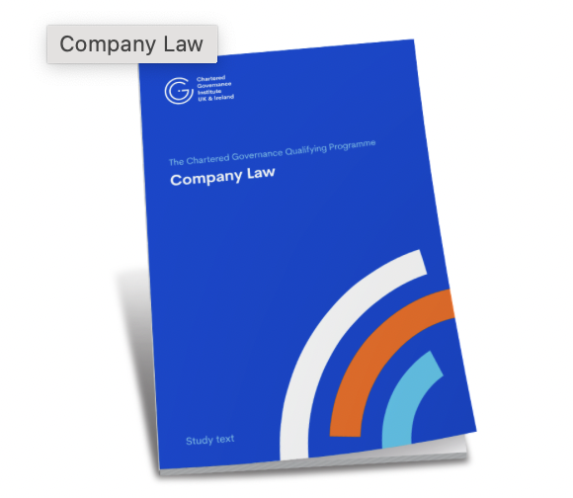
Key Learning Resources

Slide 8
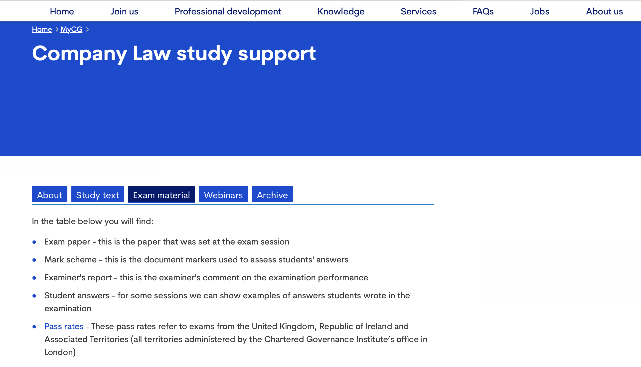
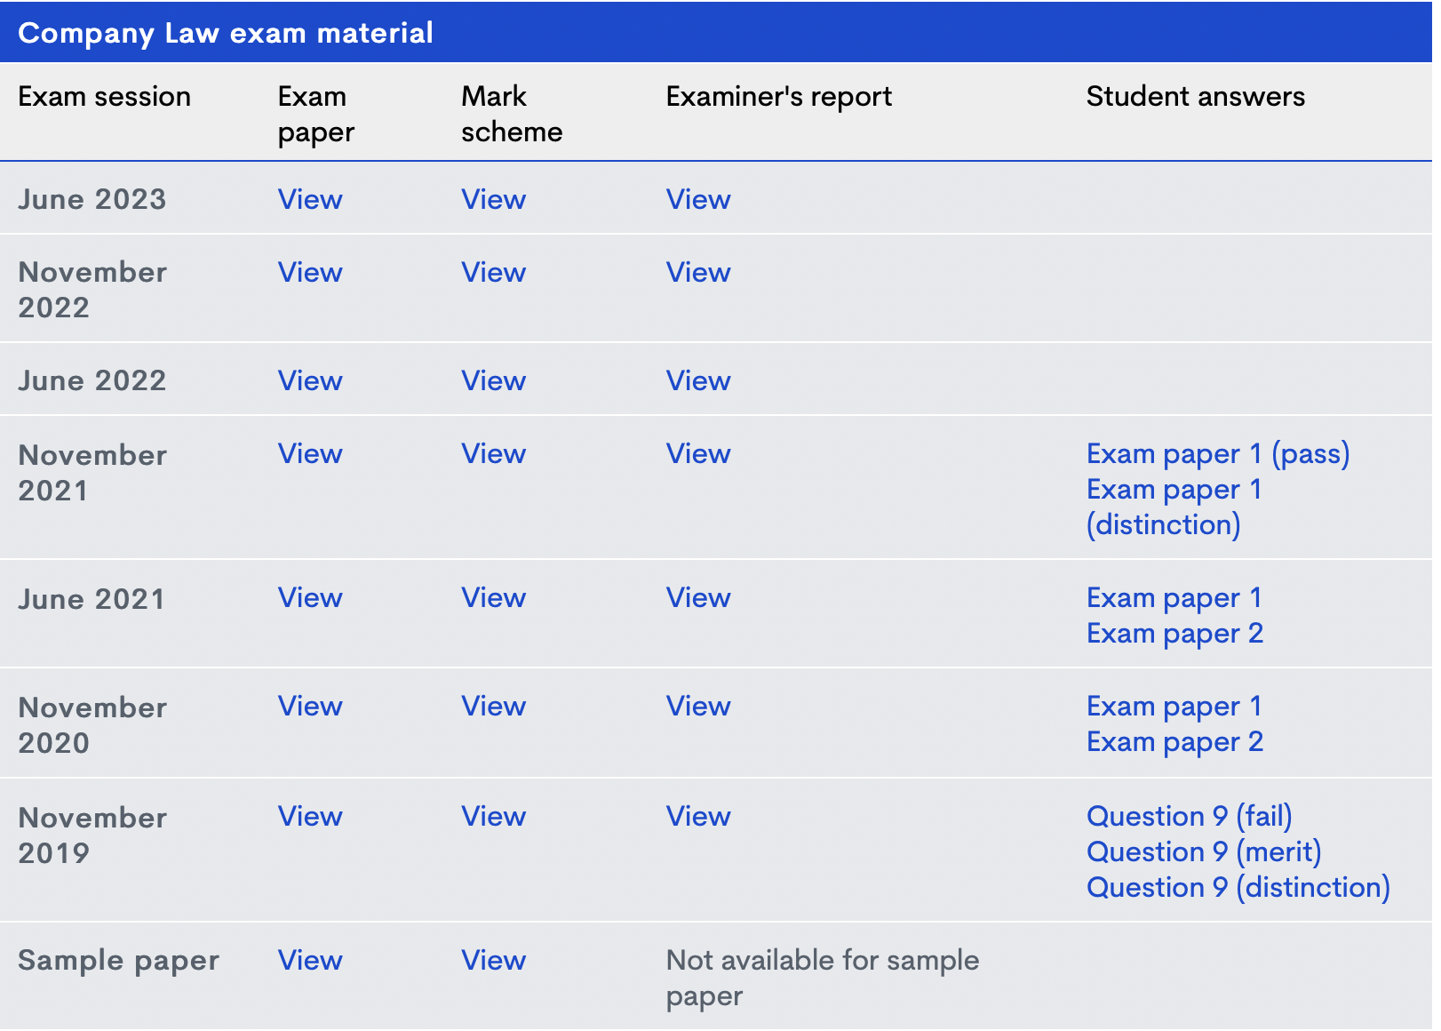
Key Learning Resources
https://www.cgi.org.uk/my_cg/qualifying-programme-part-1-2

Slide 9
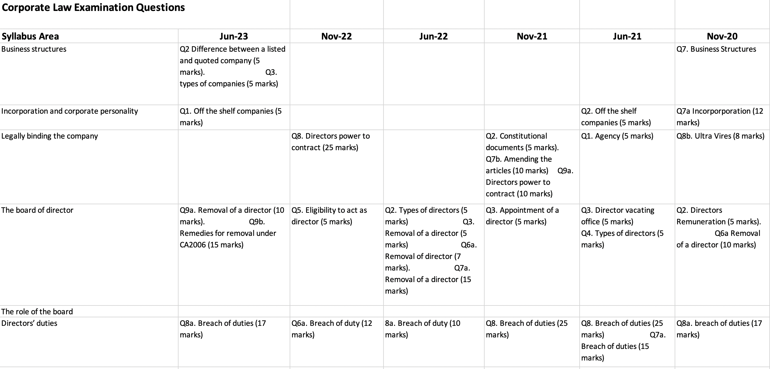
Examination Question Matrix

Slide 10
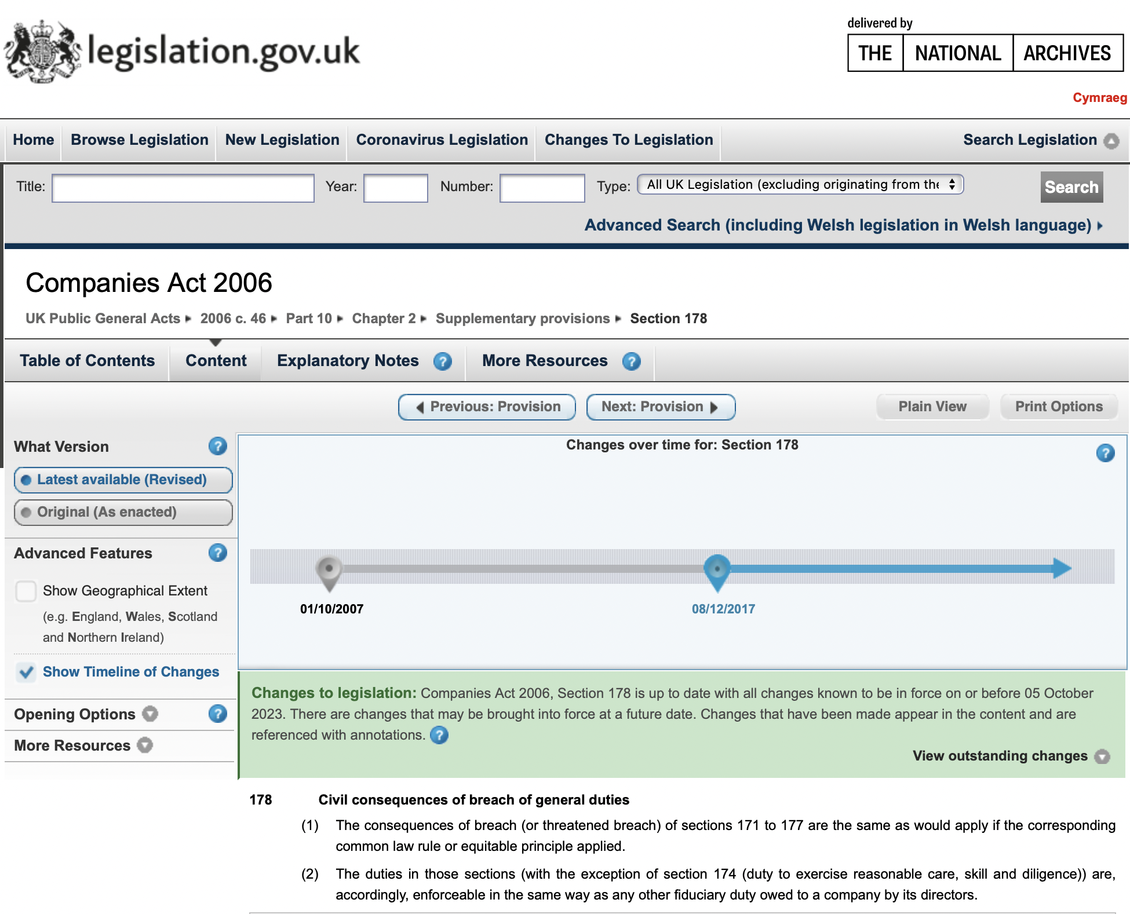
Companies Act 2006

Slide 11
Business Structures

Slide 12
Agenda
Factors affecting the structure of a business
Business Structures
      Sole proprietorship
      Partnerships
      The Company
      The Mutual Organisation
Examination Question

Slide 13
Factors affecting the structure of a business
Ownership
Liability
Regulation
Ability to raise money
Taxation
Purpose

Slide 14
Factors affecting the structure of a business
  Sole proprietorship
  Partnerships
  The Company
  The Mutual Organisation
Ownership
Liability
Regulation
Ability to raise money
Taxation
Purpose

Slide 15
Sole proprietorship
An individual carrying out business activity on their own account
Benefits
Simple to operate
Able to take on employees
Not required to disclose business information
Less regulation
Potential drawbacks
No separate personality. Liability is personal and unlimited
Notes:
Accordingly, the sole proprietor owns all the business’s assets and is entitled to all the profit that the business generates. However, the sole proprietor is also liable for all the debts and liabilities of the business. Liability is personal and unlimited, so the sole proprietor’s personal assets can be seized in order to satisfy the sole proprietorship’s liabilities.

Slide 16
Sole proprietorship
Formation and operation
Required to register as self-employed with Her Majesty’s Revenue and Customs (HMRC).
Choose a name for the sole proprietorship.
  Must file tax returns, so must maintain adequate records of all sales and purchases.
  If revenue reaches a certain amount, the sole proprietor must register for VAT purposes.
  If the sole proprietor takes on any employees, they must register with HMRC for Pay As You Earn (PAYE) purposes.
Notes:
Most sole proprietors use some form of their own name (e.g. Watson, Karen Watson, or K Watson).
Sole proprietorships are subject to much less regulation than partnerships and companies. However, sole proprietors are required to comply with the relevant rules regarding tax, namely:

Slide 17
Sole proprietorship
Finance
Can be difficult to raise finance.
  Personal investment - Risk?
  Obtain a loan – Risk?
Cannot sell shares

Slide 18
Sole proprietorship
Dissolution
Conclude operations and administration (Collect any debts owed, pay off creditors, lay off employees and so on).
Inform HMRC
Notes:
Any leftover money belongs to the sole proprietor.

Slide 19
Partnerships
A partnership is defined as ‘the relation which subsists between persons carrying on a business in common with a view of profit’
The Partnership Act 1890 (PA1890)
There are three different types of partnership:
Ordinary partnership
Limited partnership
Limited liability partnership (LLP)
Notes:
‘The relation which subsists between persons carrying on a business in common with a view of profit’ (PA1890, s. 1(1))
‘Relation’ - based upon the relationship between the partners.
‘Persons’ indicates that a single person cannot form a partnership and the partners of a partnership can be natural persons and/or legal person (for example companies )
‘Carrying on’ indicates some form of continuous activity is required, but the courts have stated that a partnership can be set up for a one-off transaction (George Hall & Sons v Platt [1954] TLR 331).
‘Business’ is defined as including ‘every trade, occupation or profession’ (PA1890, s. 45).
The partners must be carrying on the business ‘in common’. If this is not the case, it may be the case that no partnership exists.
The business must be carried on ‘with a view of profit’, indicating that a partnership cannot be set up for purely altruistic or benevolent purposes.
Ordinary partnership (also known as ‘general partnerships’ or simply ‘partnerships’)

Slide 20
Ordinary partnerships
Liability
Every partner is liable jointly with the other partners for all the debts and obligations of the partnership incurred while they are partners (PA1890, s. 9).
If a partner dies, their estate is liable for such debts and obligations (PA1890, s. 9).
The liability of the partners is unlimited.

Slide 21
Ordinary partnerships
The relationship between the partners
Usually determined by a written partnership agreement agreed by the partners, which includes:
    The right to an equal share in the partnership’s profits
    The right to take part in the management of the partnership
    A prohibition on any person being admitted as a partner without the consent of all the other partners
    A prohibition on a partner being expelled from the partnership unless all the other partners so agree.
    The terms of a partnership agreement can be altered if all the partners consent.
Notes:
but it need not be in writing – it can be oral or implied via the partners’ conduct. In order to avoid disputes, the agreement is usually in writing and will take the form of a contract.

Slide 22
Ordinary partnerships
The relationship between the partners
There is no requirement for a partnership to have a partnership agreement. ss 24 and 25 of PA1890 sets out 10 rules that determine the relationship between the partners and how the partnership is to be run including:
• All partners share equally in profits and are jointly and severally liable for losses
• Every partner is entitled to take part in the management of the company
• All partners must agree before a new partner is admitted
• All must agree before a partner is expelled

Slide 23
Ordinary partnerships
The relationship between the partners and third parties
Every partner is an agent of the firm and their acts bind the firm and all partners.
Where any wrongful act or omission of any partner acting in the ordinary causes loss or injury, or a penalty to be incurred, the firm is liable therefore to the same extent as the partner - vicarious liability.
Notes:
Vicarious Liability is a rule of law that imposes strict liability on employers for the wrongdoings of their employees. Generally, an employer can be held liable for any wrongful act committed while an employee is conducting their duties

Slide 24
Ordinary partnerships
Dissolution
A partnership can be dissolved in a number of ways, including the following:
If all the partners agree to dissolve.
The partnership agreement might provide that the partnership will be dissolved upon the occurrence of a particular event.
A partnership will be dissolved if an event occurs that makes it unlawful for the business of the partnership to carry on (PA 1890, s. 34).
Following an application from a partner, the courts can dissolve a partnership in certain cases (PA 1890, s. 35).
The relationship between the partners may break down and result in the partnership‘s dissolution.

Slide 25
Limited Partnerships
Created under the Limited Partnerships Act 1907 (LPA 1907)
Register specified documentation with Companies House
Have at least one General Partner and one or more limited partners.
Limited Partners contribute an agreed sum to the partnership and are not liable for the debts and obligations of the firm beyond that amount. Limited partners may not participate in management of the partnership and have no power to bind the firm.
Limited partnerships, although not common, do play an important role in certain areas of business (for example, venture capital, equity investment and ‘private fund limited partnership’.

Slide 26
Limited liability partnerships
Liability
An LLP is a body corporate (LLPA2000) and so has a separate personality.
The LLP is liable for the debts and liabilities of the LLP, and the LLP’s members are protected.
When an LLP is wound up, every member is liable to contribute to the LLP an agreed amount
Notes:
The principal disadvantage of an ordinary partnership is the personal and unlimited liability of the partners. A limited partner’s liability is limited, but such partners cannot take part in the firm’s management. The partners of a number of professional firms were concerned regarding their liability for professional negligence for reasons demonstrated in the following example.

Slide 27
Companies
In deciding which type of company to form the choices lies between the following:
A limited or unlimited company
If limited, between a company limited by guarantee and a company limited by shares
If limited by shares, between a private company and a public company
The Company
Limited
Unlimited
Guarantee
Shares
Private
Public

Slide 28
Companies
There are two types of unlimited companies
      a private unlimited company with a share capital
      a private unlimited company without a share capital
The liability of the members are unlimited (CA 2006, s. 3(4)).
Actions taken against company itself.
If the company cannot pay its creditors, a creditor can petition the court to have the company wound up, at which at point the members will become liable to contribute to the company’s assets.
Exempt from filing annual accounts with Companies House
Easy to return capital to shareholders
The Company
Limited
Unlimited
Guarantee
Shares
Private
Public

Slide 29
Companies
Does not have a share capital
The liability of its members will be limited by guarantee. This being the amount they have undertaken to contribute in the event of its being wound up (CA 2006, s. 3(3)
Registered at Companies House
Companies are subject to CA2006
Most companies limited by guarantee are not for profit companies
The Company
Limited
Unlimited
Guarantee
Shares
Private
Public
Notes:
This amount will be stated in the statement of guarantee submitted to Companies House when the company was incorporated.
or are engaged in some form of community-driven activity, so it is important that the members are not exposed to excessive liability upon liquidation.

Slide 30
Companies
Companies limited by shares have members, or shareholders, who own shares in the company.
Shares are transferrable.
The members have no liability for the payment of its debts and liabilities
Registered at Companies House.
Companies are subject to CA2006
Companies are subject to Corporation Tax.
The Company
Limited
Unlimited
Guarantee
Shares
Private
Public
Notes:
but are simply required to pay to the company the price they have agreed to pay for their shares.

Slide 31
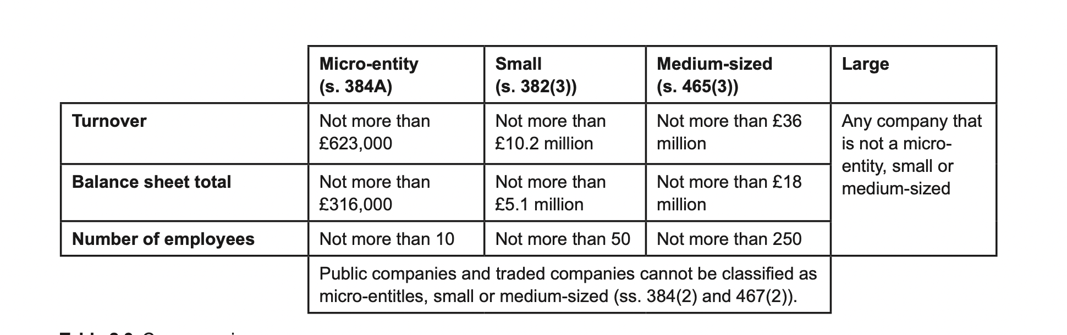
Companies
Classification of company size

Slide 32
Companies
May offer their shares to the public at large.
Minimum capital requirement of £50,000
Certain legal provisions or governance principles only apply to quoted, listed, or traded companies:
    A listed company is a company that has a class of its securities listed on the UK’s Official List (FCA Handbook)
    A quoted company is a company whose share capital has been included on the Official List; or is officially listed in an EEA state; or is admitted to dealing on the New York Stock Exchange or NASDAQ (s 385 CA 2006
  Must have a trading certificate before commencing trading
The Company
Limited
Unlimited
Guarantee
Shares
Private
Public

Slide 33
Overseas companies
A company incorporated outside the UK may wish to do business in the UK.
An overseas company is a company incorporated outside the UK (CA 2006, s. 1044).
If such a company opens a ‘branch’ or ‘establishment’ in the UK, it will be required to provide certain information to Companies House regarding the overseas company and the branch or establishment (CA 2006, s .1046; Overseas Companies Regulations 2009 (SI 2009/1801) regs 3–11).
Failure to provide this information is a criminal offence (CA 2006, s. 1054).

Slide 34
Charitable, social and community-focused companies
Company limited by guarantee
Community interest companies
Charitable incorporated organisations

Slide 35
Community interest companies (CICs)
Established by the Companies (Audit, Investigations and Community Enterprise) Act 2004 as a vehicle for companies that combine a commercial purpose with social, charitable or community-focused activities.
CICs are formed in the same manner as standard companies, except that Companies House will send the registration documents to the Regulator of Community Interest Companies.
CICs are generally subject to the CA 2006, but are also subject to additional rules found in the 2004 Act.
A CIC cannot register as a charity.
Notes:
The CIC Regulator will determine if the proposed CIC meets the ‘community interest test’, namely whether a reasonable person might consider that the company’s activities are being carried on for the benefit of the community (Companies (Audit, Investigations and Community Enterprise) Act 2004, s. 35(2)).
For example, CICs must produce an annual ‘community interest company report’ which states out how the CIC’s activities have benefitted the community (Companies (Audit, Investigations and Community Enterprise) Act 2004, s. 34; Community Interest Company Regulations 2005 (SI 2005/1788), reg 26)).

Slide 36
Charitable Incorporated Organisation (CIO)
CIOs are regulated by the Charities Act 2011 and accompanying subordinate legislation (notably the Charitable Incorporated Organisations (General) Regulations 2012 (SI 2012/3012)).
They also only deal with one regulator, the Charity Commission, whereas charitable companies that are not CIOs must deal with the Charity Commission and Companies House.
Notes:
A CIC cannot register as a charity. A company that wishes to be registered as a charity might find it more appropriateto engage in business as a charitable incorporated organisation (CIO). They also only deal with one regulator, the Charity Commission, whereas charitable companies that are not CIOs must deal with the Charity Commission and Companies House.

Slide 37
Mutual Organisations
Two specialist structures exist that can be registered with the FCA under the Co-operative and Community Benefit Societies Act 2014:
    Co-operative societies, which are run for the benefit of those members who use its services;
    Community benefit societies, which are run for the benefit of the community, and not just its members.
Examples mutual organisation include building societies, credit unions and friendly societies
Notes:
credit unions (which provide credit services to their members)
friendly societies (which usually provide financial aid to their members during periods of sickness, unemployment or retirement)

Slide 38
Questions?
Visit: www.cgi.org.uk
Kcbglobal.net
Linkedin: KCBGlobal
In association with

Slide 39
Examination Techniques
Part A
Answer PART A first and take no longer than 45 mins.
Marks are awarded for each relevant point.
Keep answers simple, to the point, using short sentences. Remember, the maximum mark to be awarded are 5.
Ensure that you don’t repeat same points
Marks are awarded for point relevant to the question rather than the topic.

Slide 40
Examination Techniques
PART B
Ensure the weighting of marks for question are carefully considered
Carefully note all the clues in the question. e.g type of company – listed or unlisted
Break question into parts and create your answer according to the parts
Present answer in format requested. e.g. Briefing note.
Consider the examiner marking the question. They are human and enjoy well presented answers.
Use the CA2006 website resources appropriately

Slide 41
Examination Question
List five types of companies that can be incorporated under the Companies Act 2006 (CA 2006). (5 marks)
Q3 Jun23

Slide 42
Companies
There are two types of unlimited companies
      a private unlimited company with a share capital
      a private unlimited company without a share capital
The liability of the members are unlimited (CA 2006, s. 3(4)).
Actions taken against company itself.
If the company cannot pay its creditors, a creditor can petition the court to have the company wound up, at which at point the members will become liable to contribute to the company’s assets.
Generally exempt from filing annual accounts with Companies House
Easy to return capital to shareholders
The Company
Limited
Unlimited
Guarantee
Shares
Private
Public

Slide 43

Examination Question
List five types of companies that can be incorporated under the Companies Act 2006 (CA 2006). (5 marks)
Q3 Jun23
The five types of company that can be created are:
• A public company limited by shares
• A private company limited by shares
• A private company limited by guarantee
• A private unlimited company without a share capital
• A private unlimited company with a share capital

Slide 44
Examination Question
Explain the difference between a ‘quoted company’ and a ‘listed company’. (5 marks)
Q2 Jun23

Slide 45
Companies
The principal legal difference between public (plc) and private companies (Ltd or Limited) is that public companies may offer their shares to the public at large.
Certain legal provisions or governance principles only apply to quoted, listed, or traded companies:
  A listed company is a company that has a class of its securities listed on the UK’s Official List (FCA Handbook)
  A quoted company is a company whose share capital has been included on the Official List; or is officially listed in an EEA state; or is admitted to dealing on the New York Stock Exchange or NASDAQ (s 385 CA 2006)
The Company
Limited
Unlimited
Guarantee
Shares
Private
Public

Slide 46
Examination Question
Explain the difference between a ‘quoted company’ and a ‘listed company’. (5 marks)
Q2 Jun23
The FCA Handbook defines a listed company as a company with a class of its securities listed on the UK official list.
Section 385 of the CA 2006 states that a quoted company is a company whose share capital:
• has been included on the (UK) official list
• is officially listed in an EEA state ; or
• is admitted to dealing on the New York Stock Exchange or NASDAQ.

Slide 47
Examination Question
Lily and James have been running a successful antiques business in partnership for the past three years. They are seeking to expand their business, and they need your advice on the most appropriate business structure. They have a large stock of furniture, paintings and other antiques, some quite valuable. They also have two vans and various tools and items of equipment. They have recently moved into larger premises, taking a lease on a large shop in London. They would also like to acquire a workshop to allow them to undertake more furniture restoration projects, but they have a few unpaid debts which they would like to pay off first. Lily and James have two possible means to raise funds for the planned expansion. One is to take a loan from their bank. The other is to borrow money from James’ parents. James’ parents have indicated that they are willing to invest capital into the business but they would need an income from their investment. They do not want to participate in the day to day running of the company, but they do expect to be consulted on major decisions. Lily and James want to retain overall control of the business themselves.
Q7, Nov 20

Slide 48
Examination Question
Prepare an advice note for Lily and James, advising them of their options and indicating how best to accommodate their wishes and those of James’s parents. (17 marks)

Slide 49
Factors affecting the structure of a business
  Sole proprietorship
  Partnerships
  The Company
  The Mutual Organisation
Ownership
Liability
Regulation
Ability to raise money
Taxation
Purpose

Slide 50
Examination Question
Trading in partnership
It appears that Lily and James are currently trading in partnership. The advantages include:
• Easy to set up and run – little formality
• Can keep all affairs private
• A flexible business structure
• Shared responsibility and decision making
Disadvantages include:
• Possible difficulties raising substantial finance
• No formal process for resolving disagreements
• The default position is that the partnership ends when partners leave
• Joint and several unlimited liability. This means that Lily and James are liable personally for the lease they have recently entered into, as well as the unpaid debts the partnership has.
Notes:
The question is designed to test candidates’ ability to apply and explain their knowledge of alternative corporate forms. Therefore, although the legal issues arising are not especially sophisticated, answers should be rewarded for identifying the numerous legal issues and decision points arising and for their clarity of explanation and advice. Answers should focus on the specific circumstances of Lily and James, and should be tailored to their preferences and priorities, although other perspectives may be explored in order to offer the best advice overall.

Slide 51
Examination Question
The Partnership Act 1890 sets out detailed rules regarding the relationship of the partners. There is no indication that there is a written partnership agreement but if there is not, PA 1890 ss 24 and 25 imply ten terms into any agreement unless the contrary is expressly agreed, including:
• All partners share equally in profits and are jointly and severally liable for losses
• Every partner is entitled to take part in the management of the company
• All partners must agree before a new partner is admitted
• All must agree before a partner is expelled
Notes:
The question is designed to test candidates’ ability to apply and explain their knowledge of alternative corporate forms. Therefore, although the legal issues arising are not especially sophisticated, answers should be rewarded for identifying the numerous legal issues and decision points arising and for their clarity of explanation and advice. Answers should focus on the specific circumstances of Lily and James, and should be tailored to their preferences and priorities, although other perspectives may be explored in order to offer the best advice overall.

Slide 52
Examination Question
Given their desire to expand, Lily and James should be advised to consider incorporating their business. This may be in the form of a limited liability partnership or a company.
LLPs have no share capital or articles, so do not address the issues identified above regarding admitting new partners or resolving disagreements. The LLP was conceived as a vehicle for professional service providers rather than small businesses so is unlikely to be suitable for Lily and James’ needs.
Lily and James may decide to incorporate their business. Answers should consider what kind of company may be most appropriate. They have the option of incorporating as a public or private company In order to set up a public limited company. A public company is suited to company’s seeking to raise investment from the public with a minimum of £50,000 share capital. At this stage, Lily and James are not looking to raise money from the public but rather from James parents., therefore a private limited company is likely to be the most appropriate vehicle for the expanding business.

Slide 53
Examination Question
Advantages of setting up a private limited company include:
• Lily and James will no longer be personally liable for the debts of the business
The company can hold assets and employ staff
• It can raise investment by issuing shares without taking a loan
• The owners’ and shareholders’ liability is limited
• Lily and James can draft the articles of association so that there is a mechanism for resolving disputes
The disadvantages are:
The company will be subject to adherence with relevant legislation (CA 2006)
The company must file its information at Companies house and will become public

Slide 54
Examination Question
Ownership and control
As Lily and James wish to retain overall control of the company’s management, they should be appointed as directors. This gives them control over day to day decision making.
James’s parents wish to make a capital investment with no responsibility for day to day management. They could therefore be shareholders, whereby they would retain a notional say on key matters via their votes in general meeting
The return on investment to James parents could come in the form as the payment of a dividend on their shares.

Slide 55
Questions?
Visit: www.cgi.org.uk
Kcbglobal.net
Linkedin: KCBGlobal
In association with

Slide 56
Legally binding the company

Slide 57
Agenda
Company contracts
The constitution of a company
Corporate capacity
Agency
Board authority

Slide 58
Company contracts
A company can enter into a contract in three ways:
By affixing its common seal to a document (ss. 43(1)(a) and 44(1)(a))
By a person who has authority (express or implied) to contract on behalf of the company (s. 43(1)(b))
Execution of a document - s. 44(2)–(8).
Notes:
A common seal is effectively a stamp that can be used to ‘sign’ or execute a document by embossing the company’s name onto the document in question. Companies are not legally required to have a common seal (CA2006, s. 45(1)) and most do not. Companies that trade internationally may retain their common seal as some overseas countries still require that a seal be used.
Who may use the common seal and its use is a matter for the company’s articles. The model articles provide that a common seal can only be used with the directors’ authority. If the seal is affixed to a document, then the document should also be signed by an authorised person (namely a director, company secretary or any person authorised by the directors to sign documents to which the common seal is applied) (model articles for private companies, article 49; model articles for public companies, article 81).
Execution of documents
A document (such as a contract) may be validly executed if it is signed on behalf of the company by (i) two authorised signatories; or (ii) a director of the company in the presence of a witness who attests the signature (CA2006, s. 44(2)). Every director of the company is an authorised signatory, as is the company secretary if the company has one (CA2006, s. 44(3)).

Slide 59
Constitutional documents
The Memorandum of Association
The memorandum states:
    The subscribers wish to form a company under the Act,
    They agree to become members of the company
    In the case of a company with a share capital, the subscribers will take at least one share each.
Historically, it contained an objects clause stating the purpose for which the company was set up.
As the memorandum could not be altered, companies found it impossible to expand into areas of business that were outside their objects
Notes:
Historically, a company’s capacity was restricted by including an objects clause in its memorandum with this clause stating the purpose for which the company was set up. The benefit of having an objects clause was that (i) it would clearly indicate to relevant persons (e.g. members, creditors) why the company was set up; and (ii) it helped ensure that the company engaged in activities in its area of expertise. If a company entered into a contract that was outside the scope of its objects clause, then that contract would be ultra vires and void (Ashbury Railway Carriage and Iron Co Ltd v Riche (1874-75) LR 7 HL 653 (HL)).

Slide 60
Constitutional documents
The Articles of Association
The articles establish the rules and procedures relating to the company and include:
The powers and responsibilities of the directors
The rules by which board meetings and general meetings will be run
The rules relating to the appointment and removal of directors
The rules relating to allotting shares and paying dividends
The rules relating to capital and borrowing powers of the company
Companies (Model Articles) Regulations 2008 (SI 2008/3229) provide model articles
Notes:
The articles of association form the company’s principal constitutional document and set out the company’s internal rules. All companies must have a set of articles (CA2006, s. 18(1)). As companies can draft their own articles, this affords companies considerable flexibility in determining how the company is to be run. Further, the CA2006 allows a company, via its articles, to exclude or modify certain statutory rules (for example, a private company can disapply pre-emption rights by including a provision in its articles to such effect).

Slide 61
Shareholders’ Agreements
An agreement entered into by two or more members which usually sets out certain rules regarding the relationship of those members
Does not form part of a company’s constitution but acts as a supplement
The terms of a shareholders’ agreement can be enforced by or against any person who is party to the agreement.
Notes:
A shareholders’ agreement can be entered into when the company is first incorporated or post-incorporation. They are typically only used by companies with a small number of members.

Slide 62
Corporate Capacity
The ultra vires doctrine
A company’s contractual capacity can be limited or restricted by its constitution
If a company exceeds its contractual capacity, then it is said to be acting ultra vires.
Historically, If a company entered into a contract that was outside the scope of its objects clause, then that contract would be ultra vires and void (Ashbury Railway Carriage and Iron Co Ltd v Riche (1874-75) LR 7 HL 653 (HL)).

Slide 63
Corporate Capacity
Unrestricted objects
A company incorporated under the CA2006 does not need an objects clause and such a company will have unrestricted objects
If a company includes or decides to retain its objects clause, then acting outside of the objects will be ultra vires.
s39(1) of the CA2006 provides that ‘the validity of an act done by a company shall not be called into question on the ground of lack of capacity by reason of anything in the company’s constitution’.
Is the ultra vires doctrine still relevant?
Directors could be in breach of duty to act in accordance with the constitution found (s. 171(a) CA2006)
Notes:
breach of duty (notably the duty to act in accordance with the constitution found in s. 171(a) of the CA2006). This might result in the company suing the directors or the members suing the directors via a derivative claim.

Slide 64
Agency
Whether a person has the authority to enter into a contract on behalf of the company.
A contract can be made on behalf of a company by a person acting under its authority. (s43(1) CA2006). The company is the principal and it will engage agents to act on its behalf.
There are two principal types of authority:
    Actual authority
    Apparent authority
However, even if an agent lacks authority, the principal can ratify the agent’s actions. (Grant v United Kingdom Switchback Railway Co (1888) 40 ChD 135 (CA)).

Slide 65
Actual authority
A legal relationship between the principal and agent created by a consensual agreement to which they alone are parties. Its scope is to be ascertained by applying ordinary principles of construction of contracts, including any proper implications from the express words used, the usages of the trade, or the course of business between the parties.
Freeman & Lockyer v Buckhurst Park Properties (Mangal) Ltd [1964] 2 QB 480 (CA)
This quote indicates that there are in fact two types of actual authority:
      Express actual authority
      Implied actual authority (apparent authority)

Slide 66
Actual authority
John is the managing director of X-Corp Ltd. X-Corp wishes to purchase a piece of machinery. The other directors of X-Corp authorise John to negotiate with potential sellers and to purchase the machinery, but only if the purchase price is less than £35,000. John enters into negotiations with Y-Corp and, on X-Corp’s behalf, he enters into a contract with Y-Corp under which X-Corp will purchase the machinery for £40,000. John states that this was the best price possible, but the other directors refuse to accept this and X-Corp refuses to honour the contract on the ground that John had no authority to make it. Y-Corp sues X-Corp.

Slide 67
Apparent authority
There is no doubt that John did not have actual authority to enter into the contract.
However, it is unlikely that Y-Corp could know this and, from its perspective, it would appear that John did indeed have authority to enter into the contract.
It might be the case that John had apparent authority. Lord Denning has stated that ‘apparent authority is the authority of an agent as it appears to others’ (Hely-Hutchinson v Brayhead Ltd [1968] 1 QB 549 (CA)).
In order to establish that an agent has apparent authority, three requirements will need to be satisfied namely:
  there must be a representation;
  this representation must be relied upon; and
  the person relying on the representation must alter their position.
Notes:
to the third party that the agent has authority to engage in the act in question and the third party then acts on that representation.
The third party must alter his position as a result of his reliance on the representation.

Slide 68
Board authority
The articles may limit the ability of the directors to contract on behalf of the company.
Section 40(1) provides that ‘[i]n favour of a person dealing with a company in good faith, the power of the directors to bind the company, or authorise others to do so, is deemed to be free of any limitation under the company’s constitution’. (s40 CA 2006)
Four points should be noted regarding s40:
    It does not bestow authority upon the directors to enter into certain contracts – it merely provides that if they act outside their constitutional authority, the contract cannot be set aside due to this lack of authority.
    It protects the contract – it does not protect the directors, who may find themselves liable, potentially for breach of the s. 171(a) duty to act in accordance with the constitution.
    It does not prevent the right of a member to bring proceedings to restrain an act that is beyond the power of the directors (CA2006, s. 40(4)).
    It cannot usually be used by a company that is a charity (s. 42(1)).
Notes:
A member is empowered to apply for an injunction preventing the directors from engaging in an act that is beyond their powers. However, in practice, this power is not especially useful as it can only be exercised if ‘no such proceedings lie in respect of an act to be done in fulfilment of a legal obligation arising from a previous act of the company’. Given that the members (especially members of larger companies) will likely not know of a transaction until after a legal obligation has arisen, the power granted to the members under s. 40(4) is severely limited in practice.

Slide 69
Persons dealing with the company
s40 can only be used by a ‘person dealing with the company’
Where a director enters into a contract on behalf of the company with himself, then that director will usually be unable to rely on s. 40 (Smith v Henniker-Major & Co [2002] EWCA Civ 762).
Any director who authorised such a transaction is liable to account for any gain he has made directly or indirectly by the transaction, and to indemnify the company for any loss or damage resulting from the transaction (s. 41(2)).
Notes:
and so it cannot be used by the company itself (such as to escape a contract entered into by directors who lacked the constitutional authority to do so). A person ‘deals’ with a company if ‘he is a party to any transaction or other act to which the company is a party’ (s. 40(2)(a)).
Section 41 provides that, where the validity of a transaction is dependent upon s. 40, then that transaction will be voidable at the company’s instance if the transaction is between the company and (i) a director of the company; or (ii) any person connected with such a director

Slide 70
Dealing in good faith
A person can only rely on s. 40 if they deal with the company in good faith. s40 itself helps establish good faith in three ways:
  a person dealing with the company ‘is not bound to enquire as to any limitation on the powers of the directors to bind the company or authorise others to do so’ (s. 40(2)(b)(i))
  a person dealing with the company ‘is presumed to have acted in good faith unless the contrary is proved’ (s. 40 (2) (b)(ii))
  a person dealing with the company ‘is not to be regarded as acting in bad faith by reason only of his knowing that an act is beyond the powers of the directors under the company’s constitution’ (s. 40 (2)(b)(iii))

Slide 71
The power of the directors
Does s.40 applies only to acts of the entire board?
s.40 refers to the power of ‘the directors which would appear to indicate that s.40 cannot apply to the acts of a single director.
There is limited case law authority stating that it can apply to a single director (International Sales & Agencies Ltd v Marcus [1982] 2 CMLR 46 (QB)). But the weight of opinion appears to be that s.40 cannot apply to a single director.
Notes:
s.40 refers to the power of ‘the directors’, whereas its predecessor (s. 35A of the Companies Act 1985) referred to the power of the ‘board of directors’. This reformulation would indicate that s. 40 applies to acts of the entire board and acts of multiple directors.
Pre-2006 case law held this to be the case (Criterion Properties plc v Stratford UK Properties LLC [2004] UKHL 28).

Slide 72
The ‘indoor management’ rule
Third parties that deal with the company can assume that the company’s internal rules have been complied with.
Royal British Bank v Turquand (1856) 6 El & Bl 327
The board of a company purported on behalf of the company to borrow £2,000 from a bank. The company’s deed of settlement provided that the directors could only borrow sums on behalf of the company if authorisation was obtained from the general meeting. The directors did not obtain such authorisation. The company defaulted on the loan and the bank commenced legal proceedings against the company, which was in liquidation. The company’s liquidator argued that (i) the directors had no authority to borrow the money on the company’s behalf and so the company was not bound by the loan agreement; and (ii) the bank should bear the loss as it failed to inform itself of the directors’ lack of authority.
Jervis CJ held that the company was bound to pay back the money to the bank. He stated that ‘[f]inding that the [directors’] authority might be made complete by a resolution, [the bank] would have a right to infer the fact of a resolution authorising that which on the face of the document appeared to be legitimately done’. In other words, the bank was entitled to assume that the directors had complied with the articles.

Slide 73
Questions?
Visit: www.cgi.org.uk
Kcbglobal.net
Linkedin: KCBGlobal
In association with

Slide 74
Examination Question
Kim, Li and Sasha are the directors of BlumtBlumt plc (‘Blumt’), a manufacturer of electrical components for car engines.
Blumt has 1,000 shares, as follows:
200 shares are held by Lightning plc.
Kim, Li and Sasha each hold 200 shares.
Ashley, a venture capital investor, holds 200 shares.
Blumt was incorporated in 2017 and has adopted the model articles, with the addition of the following clause: “The business of Blumt plc is the manufacture of electrical components”.
Blumt has made a small profit every year since incorporation, but it has never paid a dividend to its members, instead using the profit to increase directors’ salaries.
The directors recently decided to expand the company’s activities to include the sale of car accessories, including seat covers, air fresheners and floor mats. The Board has signed a contract with a large international supplier of accessories, Floral Ltd (Floral). On signing the contract, Blumt made a payment to Floral of £200,000 for its first product order.
Ashley believes that the lack of a dividend, the diversification of activities and the contract with Floral have all had a negative impact on the company’s business and made it more difficult to sell shares in Blumt. He is worried that his shares may now be worth less than his initial investment.

Slide 75
Examination Question
Advise Ashley:
(a) Whether the payment to Floral can be recovered.
(b) Whether he has any other remedies in respect of the directors’ activities.
(25 marks)

Slide 76
Examination Question
A company incorporated under CA 2006 is not required to have an objects clause. Prior to this, objects clauses were part of the Memorandum of Association and had the effect of limiting the activities of the company, with no way of changing the clause. Since the CA2006, companies can elect to include an objects clause in their articles as Blumt has done. The effect being to restrict the company’s contractual capacity in areas outside its objects
As the directors have signed a contract which is not in accordance with the company’s object, the contract will be ultra vires. Historically, this would render the contract void, but this is no longer the case.
Section 39 CA 2006
Section 39 provides that the validity of an act done by a company shall not be called into question on the ground of lack of capacity by reason of anything in the company’s constitution.
The result of this is that a contract cannot be invalidated on the ground that it is outside the scope of the company’s objects. Thus s.39 protects third parties like Floral. The contract remains valid and the £200,000 cannot be reclaimed from Floral.

Slide 77
Questions?
Visit: www.cgi.org.uk
Kcbglobal.net
Linkedin: KCBGlobal
In association with

