Slide 1
Corporate Governance
Week 1 – Introduction

Slide 2
Agenda
Introductions
Introduction to CG examination
Our approach to preparing for the examination
Introduction to CG module
Learning Schedule
Our Learning Case Study

Slide 3
CG Examination
Exam Format
5 short questions of 5 marks each. Compulsory
3 from 4 Scenario based questions of 25 marks each covering multiple syllabus areas
Pass mark: 50%
Pass Rate: 39% (Nov 23)
Syllabus coverage & Weighting

Slide 4
Why do students fail?
Insufficient knowledge and understanding of syllabus area
Inability to apply knowledge and understanding to scenarios
Examination Technique

Slide 5
Bloom’s Taxonomy
Key Words – Explain, Compare, Contrast, Identify, Apply, Plan, Solve

Slide 6
Our approach
Knowledge
40%
Building & Testing Knowledge
Exploring
20%
Understanding how the knowledge links with other areas of the syllabus and the context in which it will appear in examination questions
Practice
40%
Practising examination questions

Slide 7
Our approach
Weekly Session
Part 1: Test and recap on previous week
Part 2: Introduce new learning
Part 3: Review Examination Questions
Part 4: Discuss Follow up Tasks
Post Weekly Session
Undertake Follow up Tasks

Slide 8
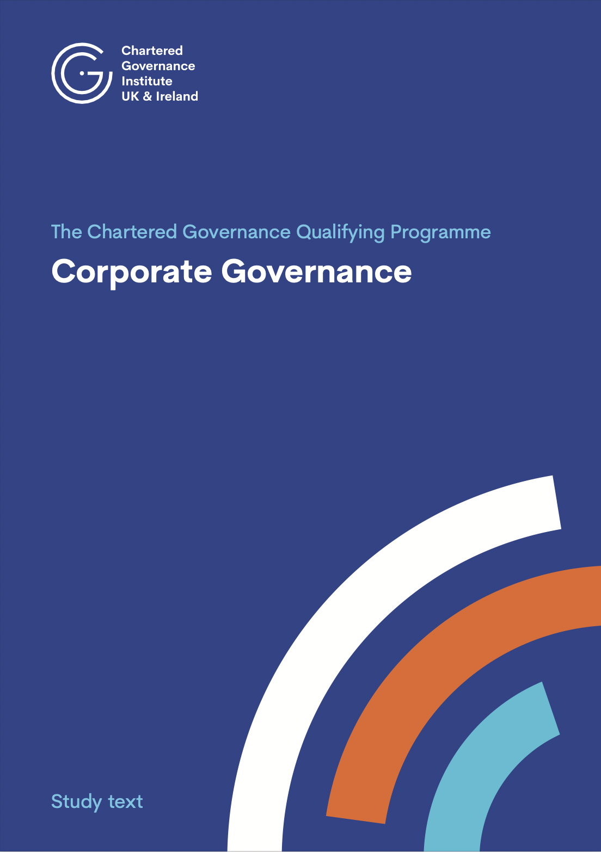
Key Learning Resources

Slide 9
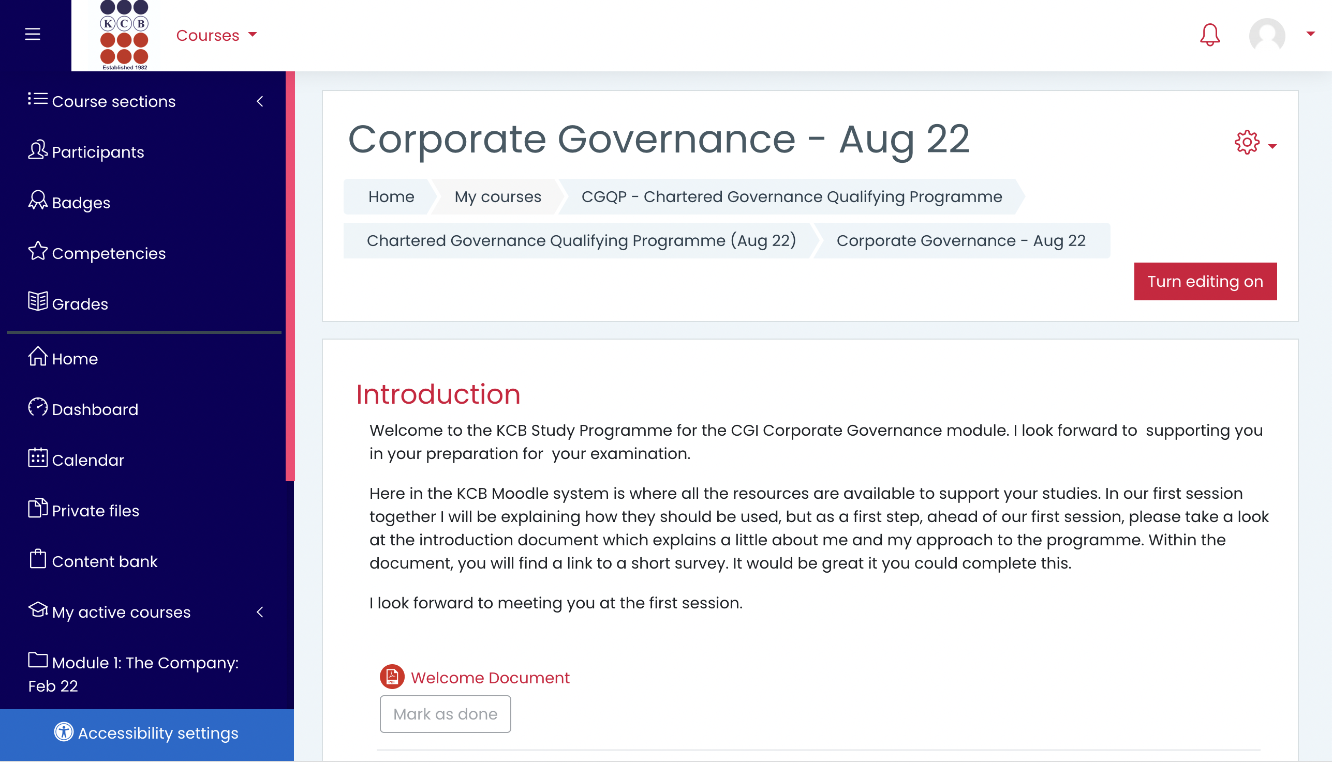
Key Learning Resources

Slide 10
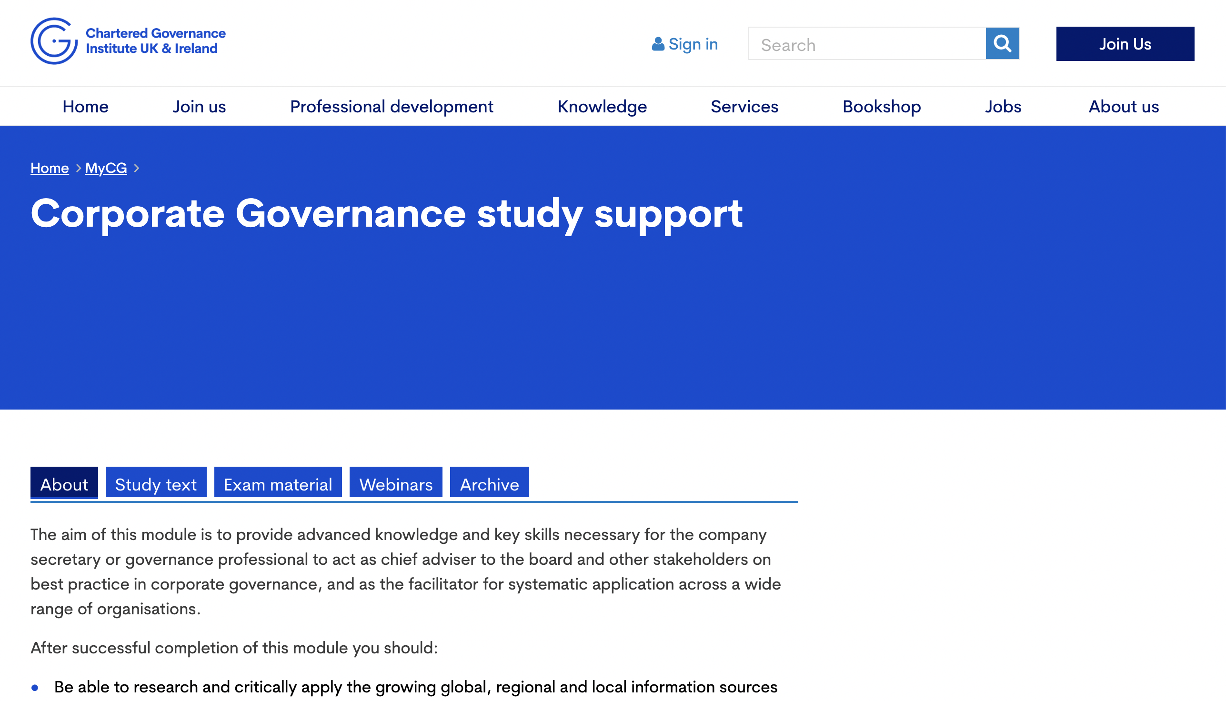
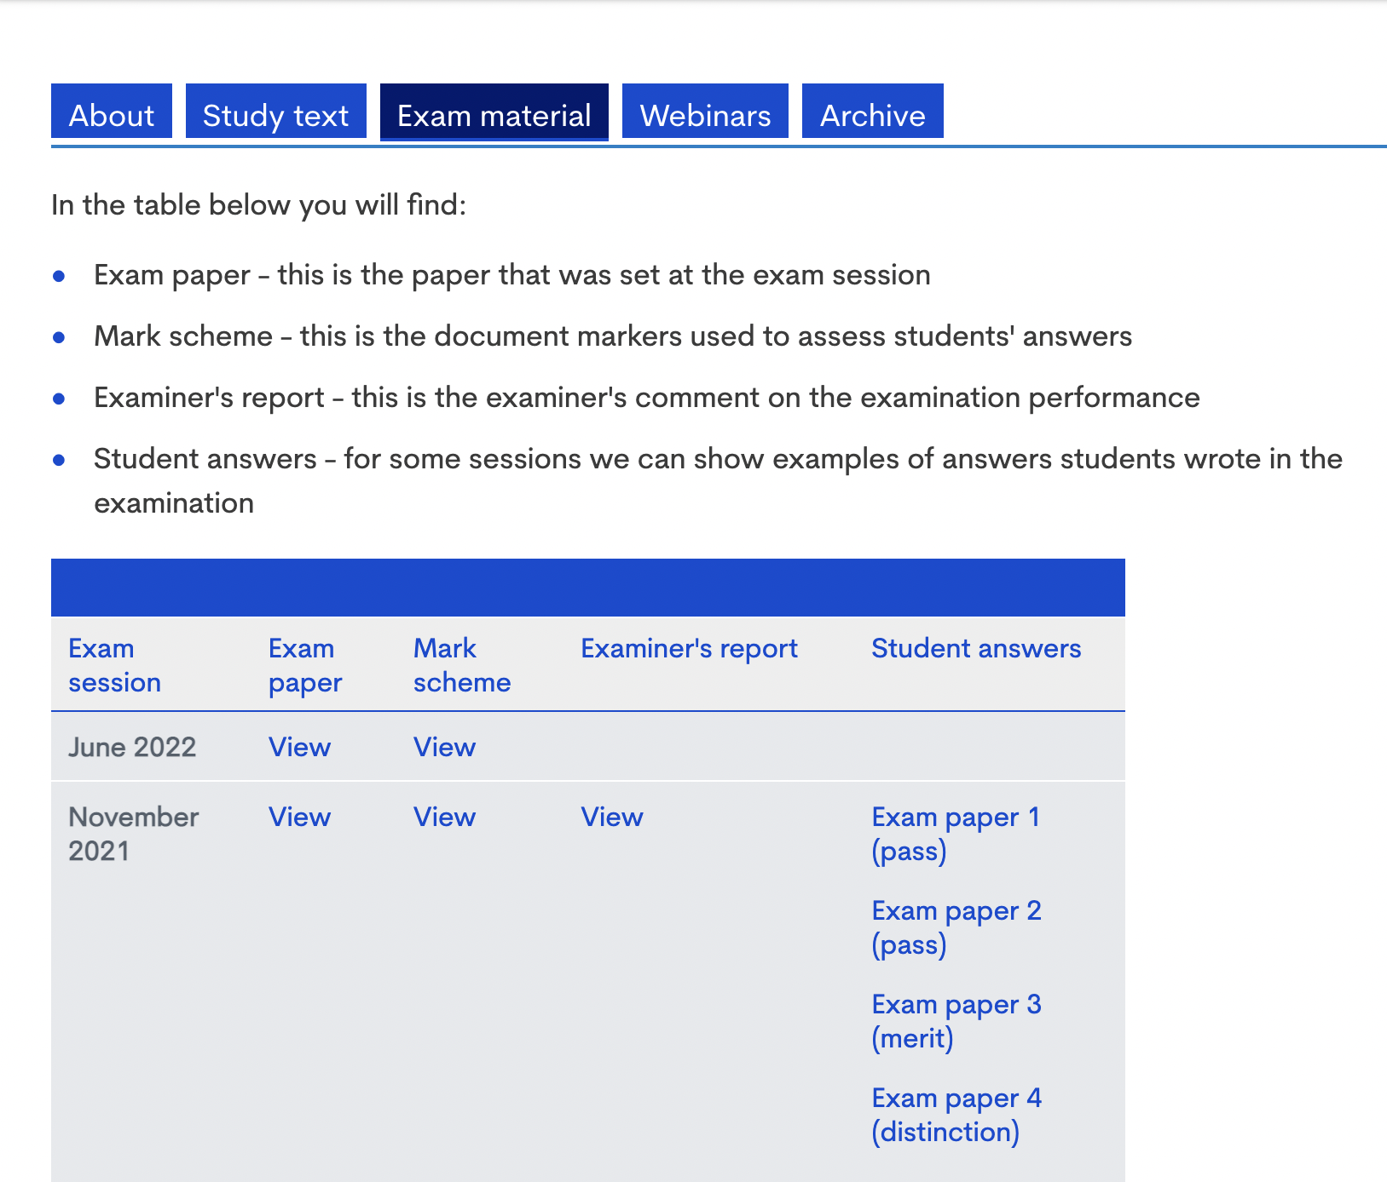
Key Learning Resources
https://www.cgi.org.uk/my_cg/qualifying-programme-part-1-2

Slide 11
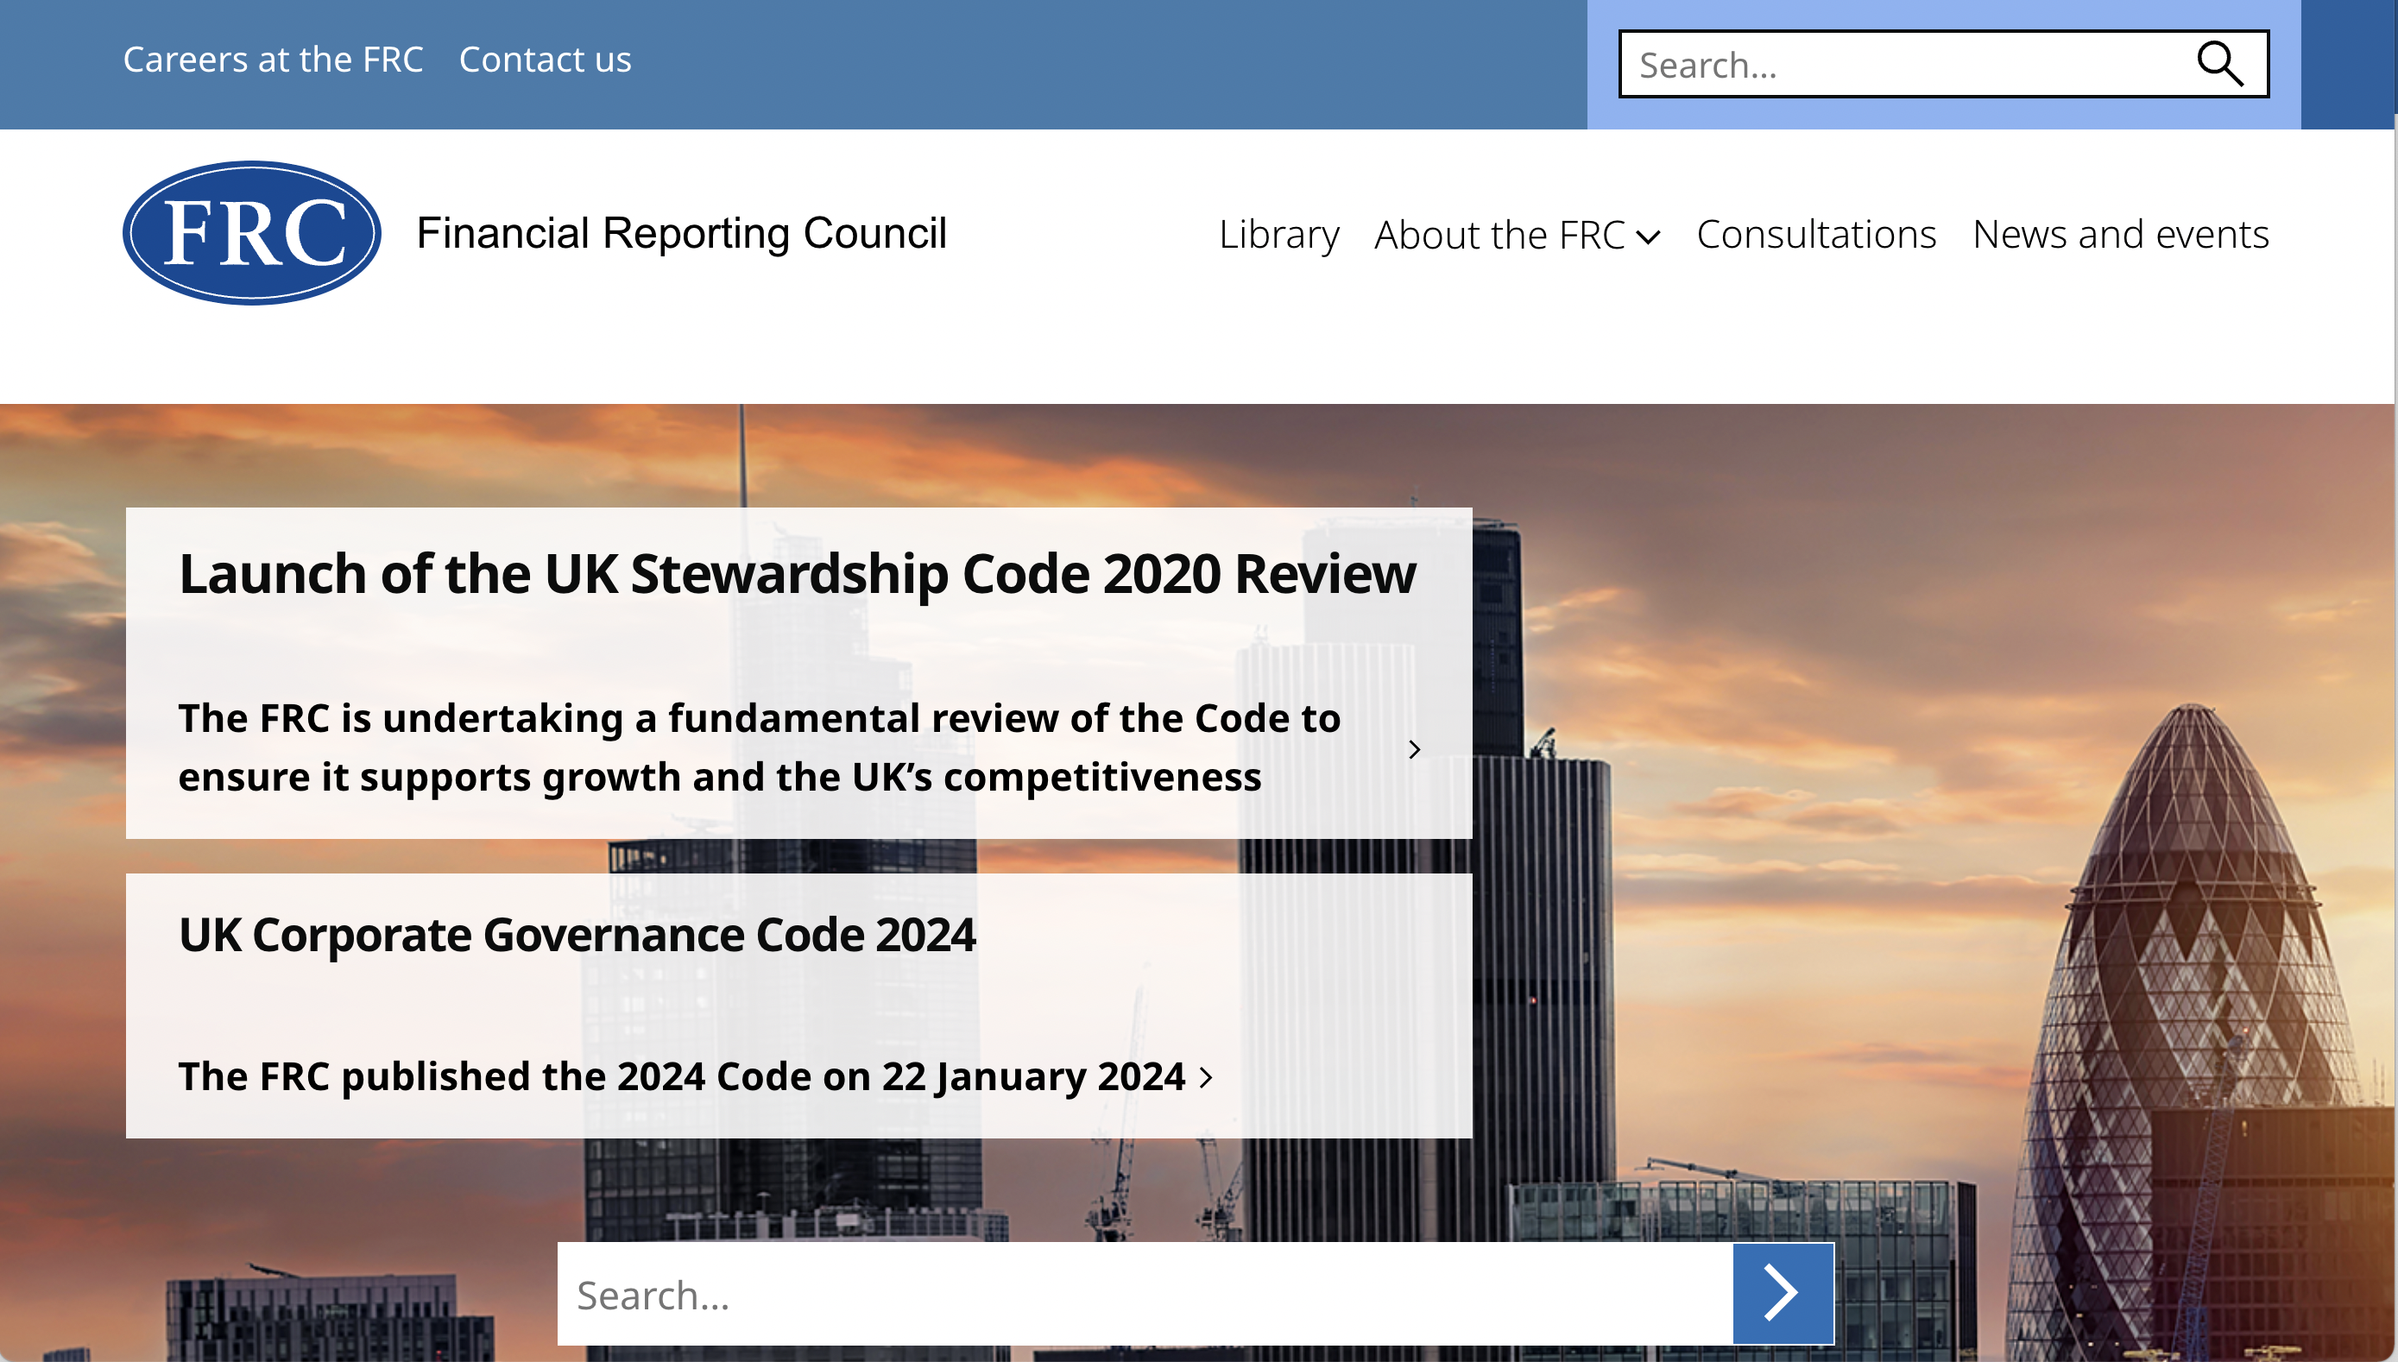
Key Learning Resources

Slide 12
Definitions of Corporate Governance
‘The system by which companies are directed and controlled’
The Cadbury Committee 1992

Slide 13
Corporate Governance Case Study

Slide 14
The Board
Kenneth Lay
Chairman
Jeffrey Skilling
CEO
Andrew Fastow
CFO
‘The smartest guys in the room’

Slide 15
Share Price Performance
311% increase in stock price between 1990 – 1998
56% growth in 1999
87% growth in 2000
Market Capitalisation $60bn

Slide 16
Accounting Policies
Special Purpose Entity

Slide 17
The Auditors
$25m in Audit Fees
$27m in Consulting Fees
27% of revenue for Andersen’s Houston Office
Pressure Conflict of Interest

Slide 18
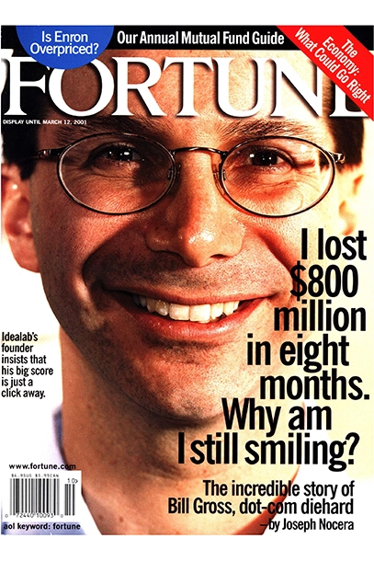
The Cracks

Slide 19
The ‘Whistleblower’
Sherron Watkins
Vice President, Corporate Development
“ I am incredibly nervous that we will implode in a wave of accounting scandals.”

Slide 20
The Collapse
The largest bankruptcy in US history

Slide 21
The Aftermath
15,000 Enron Employees lost their jobs
85,000 Arthur Andersen employees lost their jobs
Enron investors lost all their money
Implementation of Sarbanes-Oxley

Slide 22
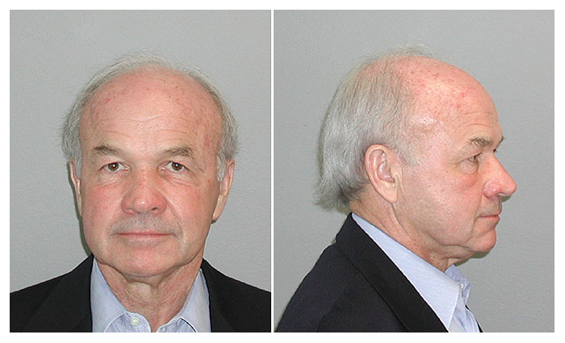
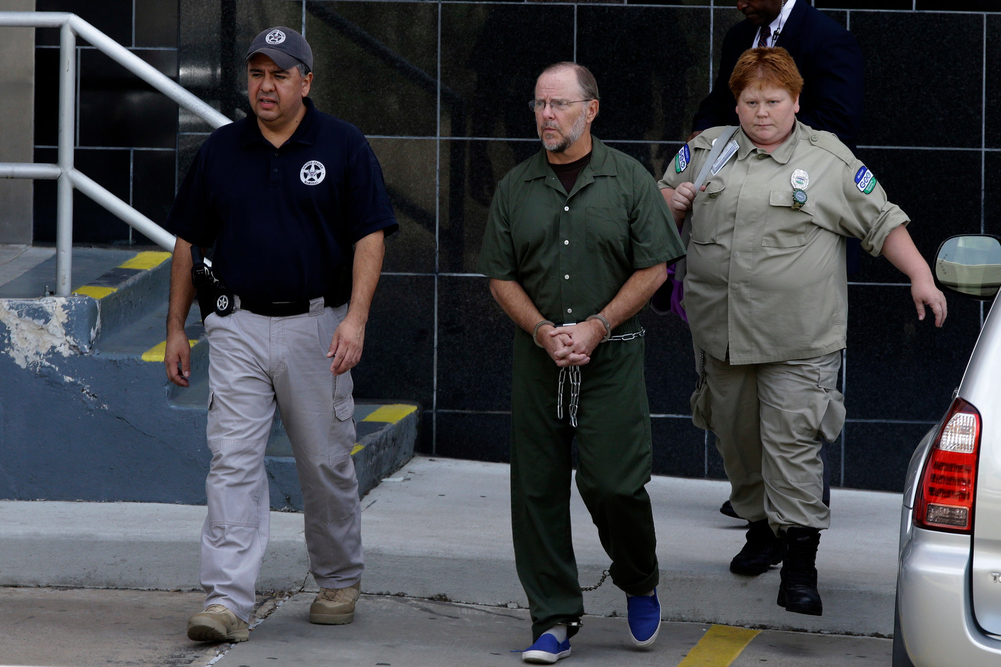
The Aftermath
Kenneth Lay
Chairman
GUILTY
45 Years in Jail
Jeffrey Skilling
CEO
GUILTY
24 Years in Jail
Andrew Fastow
CFO
GUILTY
10 years in Jail

Slide 23
Question
Can ‘Enron’ happen again?

Slide 24
UK Governance Failures
Autonomy Corporation Plc 2011
What?
Valuation of $11.1bn
How?
Lack of effective board oversight
Creative accounting and failure of internal controls
Deloitte’s reliance on Autonomy, as the only FTSE 100 company in its Cambridge office

Slide 25
UK Governance Failures
2014 Tesco Plc
What?
In August 2014 Tesco PLC issued its six month trading update with an estimated profit of £1.1 billion
Less than a month later the retailer announced a £250 million profit overstatement
How?
Major failure of oversight by the board
Toxic corporate environment
Creative accounting
PwC reliance on Tesco Plc

Slide 26
UK Governance Failures
2018 Carillion Plc
What?
The collapse of the UK’s second largest construction company
Over 18,000 jobs in UK at risk
£2.6 billion pension deficit
How?
Lack of effective management oversight
An aggressive accounting strategy and abuse of accounting principles
Audit failures - KPMG

Slide 27
UK Governance Failures
1995-2005 The Post Office
What?
4,000 sub postmasters accused of financial wrongdoing,
900 prosecutions
700 convictions
236 people sentenced to prison
How?
Faulty IT System
Board Failure ?
Remuneration ?

Slide 28
Schedule
WK 2
Corporate Governance – An introduction
WK 3
Role of the company secretary and the board of directors
WK 4
Directors – Duties, powers and Remuneration
WK 5
Board Composition and Effectiveness
WK 6
Financial reporting to shareholders and external audit
WK 7
CSR and Reporting on non-financial issues
WK 8
Risk management
WK 9
Shareholder rights and engagement
WK 10
Other governance issues

Slide 29
Wk 1 Tasks
Watch video ‘Introduction to Corporate Governance’ – KCB Moodle (20 mins)
Access Study Resources via CGI website and view structure of Nov 23 Examination Paper and Mark Scheme (10 mins)

