Slide 1
Corporate Governance Examination Revision – Session 1
Neill McWilliams MSc,MBA,FCG

Slide 2
Agenda
Examination Advice
Role of the company secretary in governance
Overview of knowledge
Examination practice
Role and membership of the board of directors
Overview of knowledge
Examination practice

Slide 3
Schedule of Sessions
Session 1: Role of the company Secretary in Governance
Role and membership of the board of directors
Session 2: Directors’ duties and powers
Remuneration of directors and senior executives
Session 3: Board composition and succession planning
Board effectiveness
Session 4: Financial reporting to shareholders and external audit
Risk

Slide 4
Examination Format
Part A: 5 compulsory short questions of 5 marks each.
Part B: 3 from 4 scenario-based questions of 25 marks. Each question covers multiple syllabus areas
Pass mark: 50%
Pass Rate: 44% (June 2023)

Slide 5
Learning Outcomes
After successful completion of this module you should:
1. Be able to research and critically apply the growing global, regional and local information sources on corporate governance.
2. Be able to advise on the duties of directors as well as the role, membership, composition and effectiveness of the board, within legal and regulatory frameworks.
3. Be able to apply the concepts of disclosure in terms of accountability, transparency, corporate social responsibility, ethical standards and sustainability in governance.
4. Be able to critically appraise and apply corporate governance principles and best practices in risk management for the board in the employing or client organisation.
5. Be able to exercise appropriate judgment in the use of professional knowledge and skills to the resolution of practical issues and problems in the proper governance of an organisation
Notes:
Higher order learning

Slide 6
Your approach to preparation for the examination
Knowledge
40%
Building & Testing Knowledge
Exploring
20%
Understanding how the knowledge links with other areas of the syllabus and the context in which it will appear in examination questions.
Practice
40%
Practising examination questions

Slide 7
Key Learning Resources

Slide 8
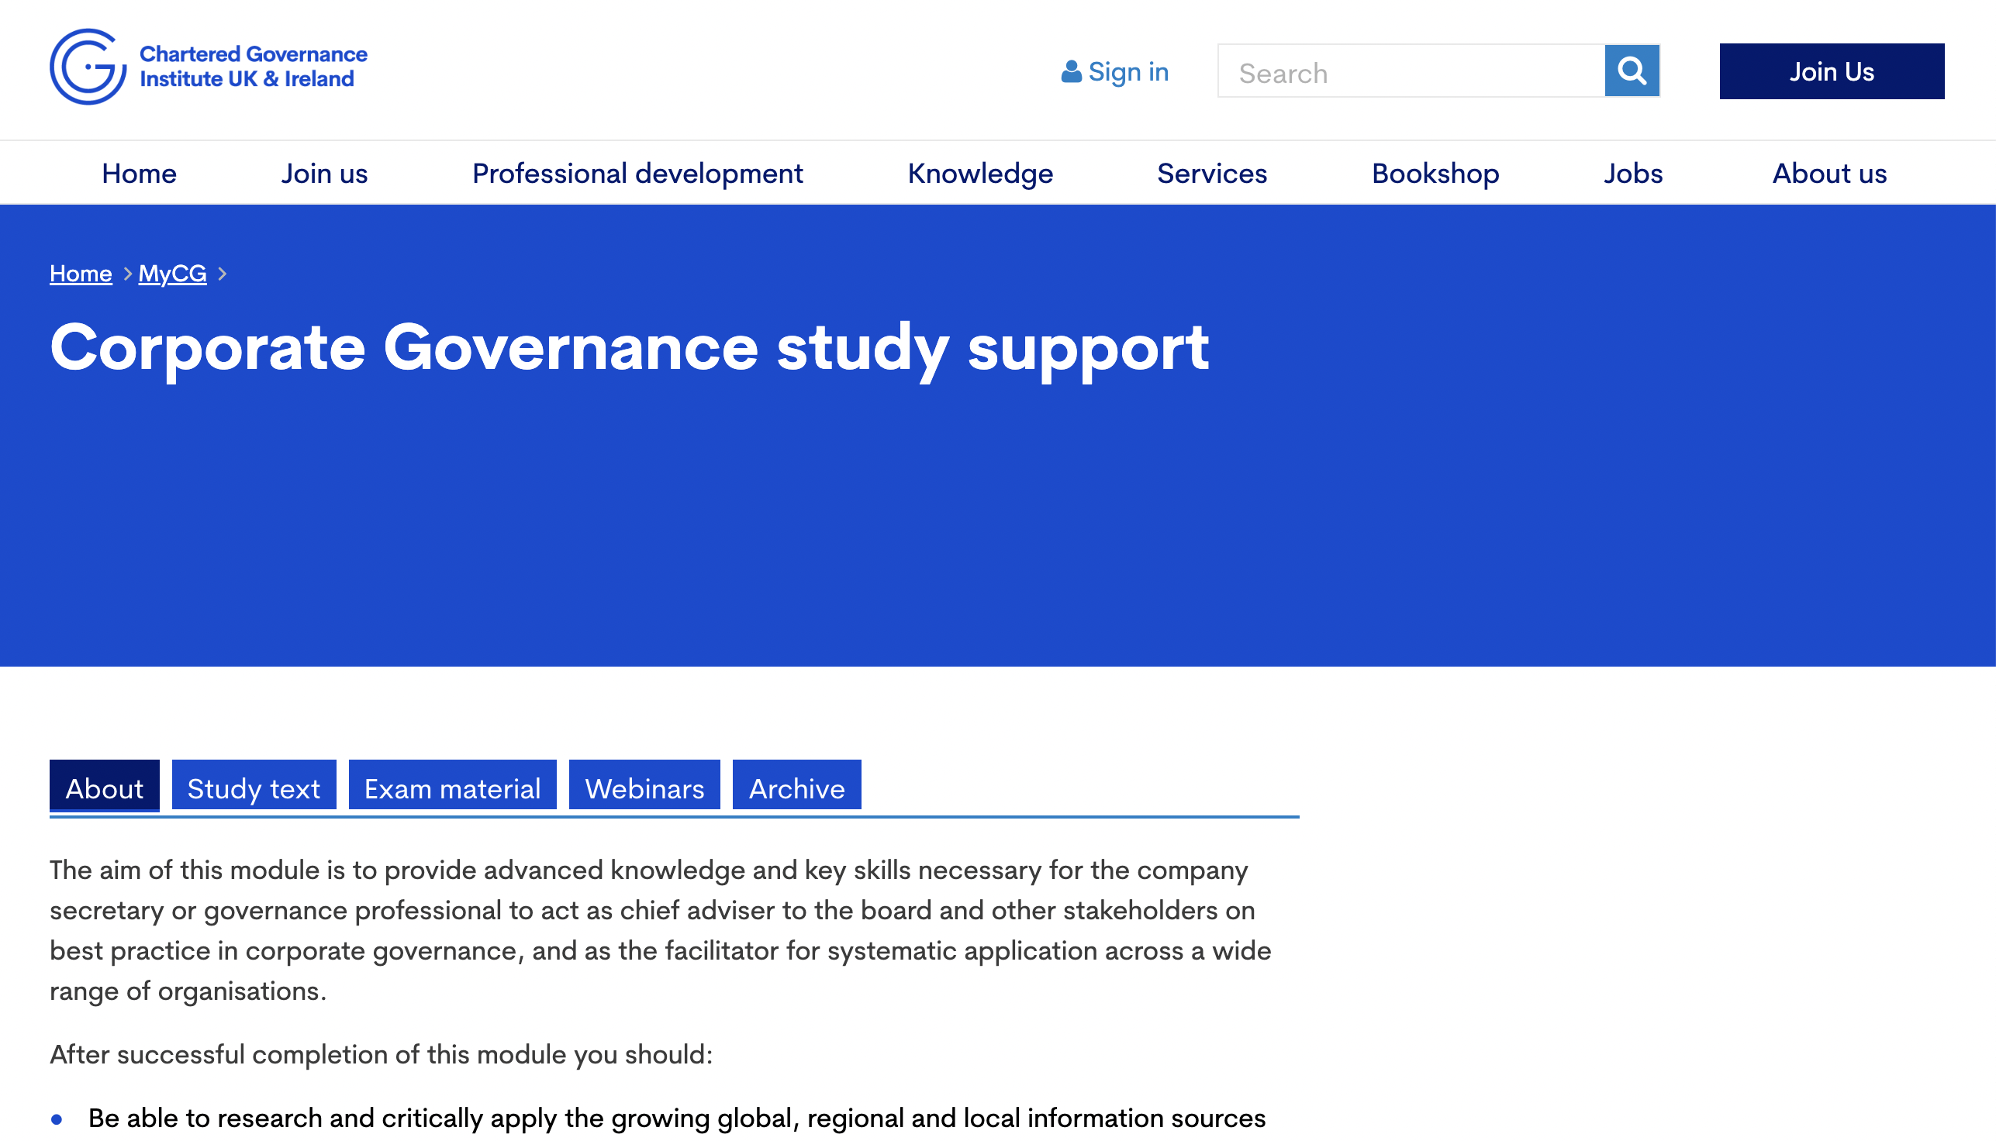
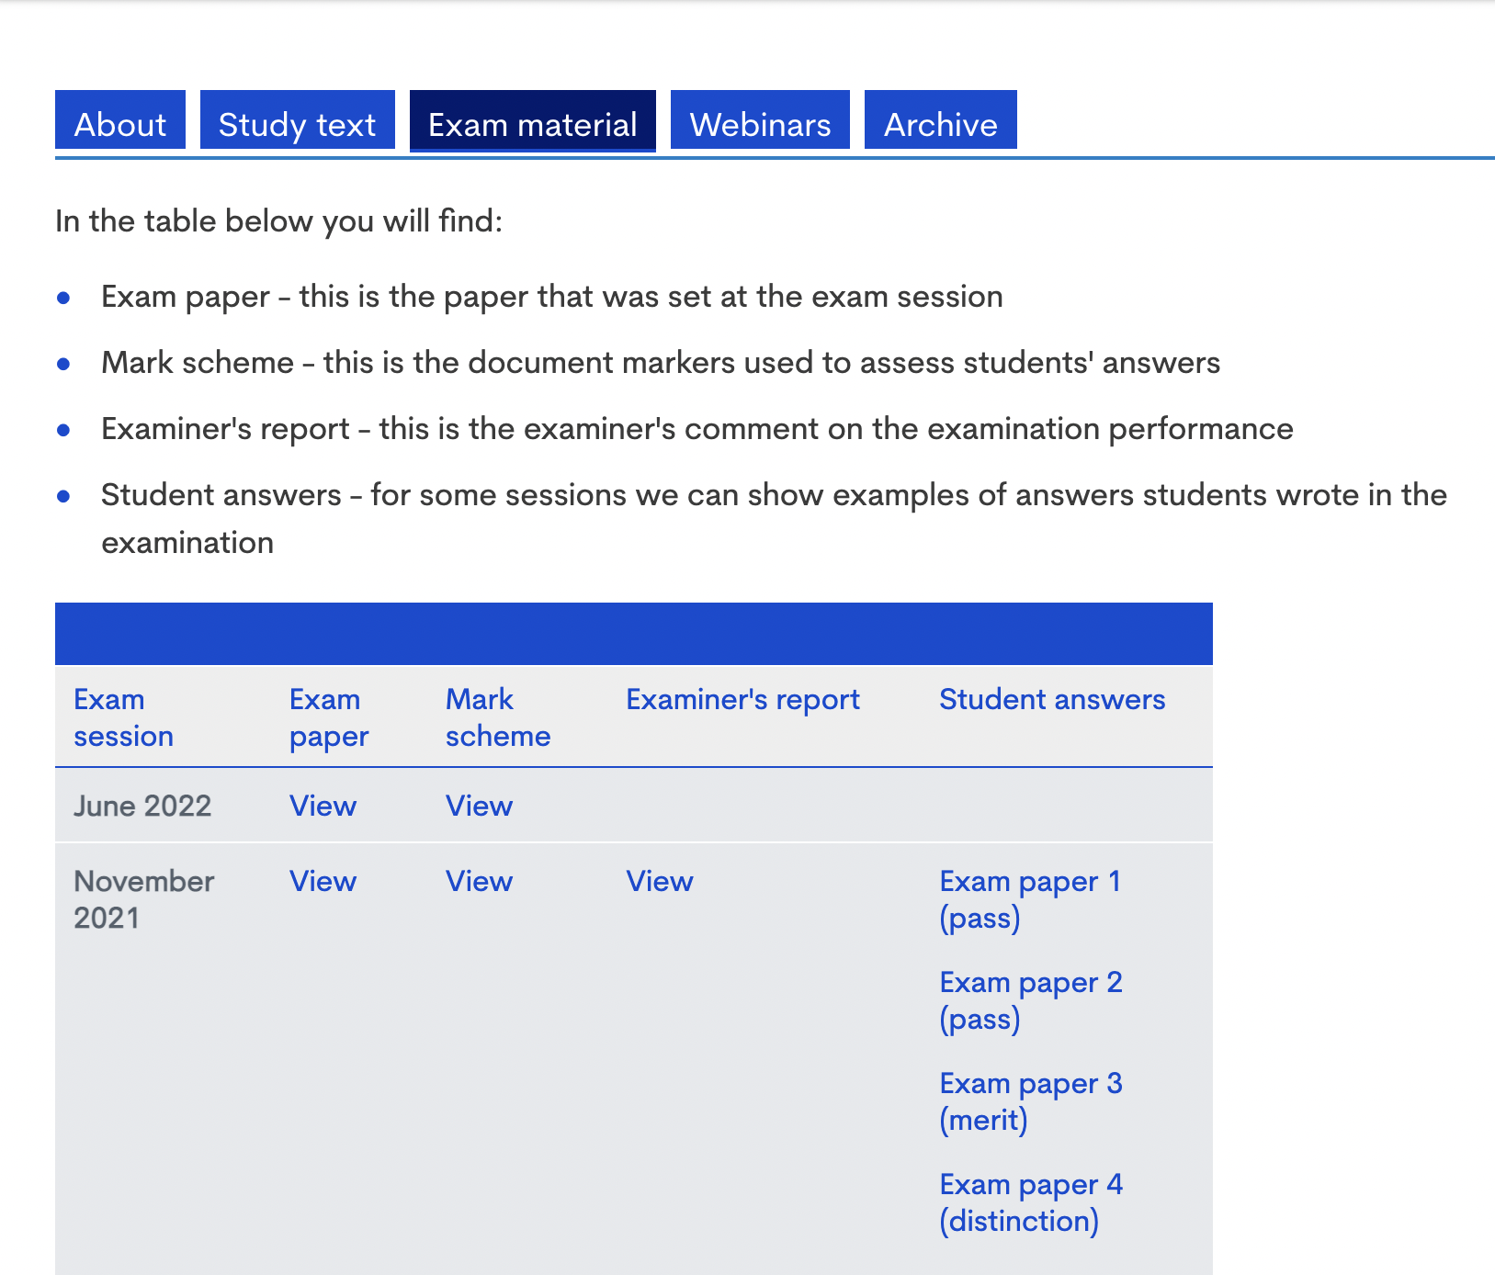
Key Learning Resources
https://www.cgi.org.uk/my_cg/qualifying-programme-part-1-2

Slide 9
Key Learning Resources

Slide 10
Examination Question Matrix

Slide 11
Role of the company secretary in governance

Slide 12
Introduction
Shareholders
Other
Stakeholders
The Board
Chairman
Directors
Non Executive Directors
Company Secretary
Management

Slide 13
The role of the company secretary
Governance
Statutory and regulatory compliance
Advising the board and senior management
Communication

Slide 14
The role of the company secretary
Governance
Board composition and procedures
Schedule of matters reserved for the board
Support for meetings
Ensuring appropriate insurance
Ensuring board committees are properly constituted
Supporting the board in succession planning

Slide 15
The role of the company secretary
1. Governance
Board Information, development and relationships
Induction programmes for new directors
Supporting directors’ professional development
Arranging meetings with major shareholders
Facilitating good information flow
Establishing procedures for directors’ independent advice
Establishing oneself as primary contact for NEDs
Supporting board evaluation process

Slide 16
The role of the company secretary
1. Governance
Accountability
Supporting and advising on boards responsibility in presenting understandable assessment of the company’s position and prospects
Supporting Risk review and internal control systems
Supporting Audit committee understand responsibilities
Ensuring ‘Whistleblowing’ policy

Slide 17
The role of the company secretary
1. Governance
Remuneration
Supporting Remuneration Committee
Ensuring compliance with directors’ remuneration legislation and rules
Relationship with shareholders
Disclosure and Reporting

Slide 18
The role of the company secretary
2. Statutory and regulatory compliance
Directors’ duties
Supporting adherence to CA2006
Share dealing
Inside information

Slide 19
The role of the company secretary
3. Advising the board and senior management
Good board practice
Board and committee constitution and procedures
Board evaluation
Induction and ongoing training
Statutory duties and responsibilities
Commitment to Corporate Responsibility
Commitment to Corporate Governance

Slide 20
The role of the company secretary
4. Communication
Communicating all board decisions to management, regulators and other stakeholders
Liaising with board members for all board events
Primary point of contact with NEDs
Ensuring board communication with shareholders
Supporting in preparation of the annual report

Slide 21
The company secretary as the ‘conscience of the company’
Advising the board on the right thing to do in the long-term interests of the company
Based on:
Independence
In depth knowledge of company
Strong governance and ethical understanding
Good relationship with the board

Slide 22
Qualifications of the company secretary
Hold one or more of the following qualifications:
Have been a secretary of a public company for at least three years of the five years immediately preceding his or her appointment;
Is a member of one of the following seven professional bodies:,
the Institute of Chartered Accountants in England and Wales;
the Institute of Chartered Accountants of Scotland;
the Association of Chartered Certified Accountants;
the Institute of Chartered Accountants in Ireland;
the Institute of Chartered Secretaries and Administrators;
the Chartered Institute of Management Accountants;
the Chartered Institute of Public Finance and Accountancy; and
is a qualified barrister or solicitor.
Be a person who appears to them to have the requisite knowledge and experience to discharge the functions of the secretary.
s273 CA2006

Slide 23
The skills of the company secretary
Communication
Interpersonal skills
Practical skills
Commercial and business acumen

Slide 24
Independence of the company secretary
‘Boards have a right to expect the company secretary to give independent, impartial advice and support to all the directors, both individually and collectively as a board.’
CGI Guidance note, 2014
If the company secretary role is combined with another role such as that of the in-house lawyer or accountant, care should be taken to see that the governance role is not compromised. A general counsel who is also given the role of the company secretary will often have to take sides in fulfilling their legal role to represent the particular interests of the company.

Slide 25
Position of the company secretary
Appointment and Removal
The company secretary should be appointed and dismissed by the board as a whole.
Reporting lines
The company secretary is responsible to the board and should be accountable to the board through the chair on all matters relating to corporate governance and their duties as an officer of the company.
Remuneration
Decisions on the remuneration and benefits of the company secretary should be taken by the board or by the remuneration committee.
Evaluation
To be carried out as part of the annual board evaluation.
CGI Guidance Note, 2013

Slide 26
General Counsel and the role of the company secretary
CGIUKI Position
“Both the general counsel and company secretary role are important in a business. There can be some overlap between the two, but they are distinct functions and businesses are governed best when the two roles – and the roles of the chief risk officer and head of internal audit - work collaboratively, but with respect for the duties that each role should carry out.”
Peter Swabey, Policy and Research Director CGIUKI said:
“I have always seen a combined role of company secretary and general counsel or finance director, or one where the company secretary reports to the general counsel or finance director as a conflict of interests waiting to happen. It may all work OK but, if an individual has to give different advice to the board depending on which ‘hat’ they are wearing, there is a conflict and it is then a bit too late to start dealing with the conflict as well as the issue. All are important roles but they are distinct and complementary.”

Slide 27
Examination Questions from previous papers
Explain, with reference to the four main categories of the role of a Company Secretary, how Molly can assist the focus group and the Board on corporate social responsibility issues. (12 marks)
Q7a, Jun22
Analyse the role that Matteo, as the Company Secretary of Topnotch, should play in improving the relationship between members of the Board, and between the Board and the senior management team, and the skills that he needs to use to ensure that they are working together effectively. (12 marks)
Q8b, Nov 21
Explain how a Company Secretary could assist Jenny on Board and governance issues, with reference to the four main categories of roles that a Company Secretary could perform for Ocean, in contrast to the Executive Assistant’s role. (8 marks)
Q6b, Nov20

Slide 28
Examination Questions from previous papers
Explain why the reporting lines of a Company Secretary are important and how those reporting lines should be managed if the Company Secretary is also the company’s in-house legal adviser. (5 marks)
Q2, Jun21
Discuss whether it would be possible for Ocean to appoint a Company Secretary who also works in the Ocean finance team and what issues this would raise. (8 marks)
Q6b, Nov20
Assess what risks a Company Secretary could face to his or her independence when performing their governance role and how those risks can be reduced. (13 marks)
Q10b, Nov2019
Describe how a company can ensure that its Company Secretary is able to give independent advice to the Board. (5 marks)
Q4, Jun2023

Slide 29
Examination Techniques
Part A
Answer PART A first and take no longer than 45 mins.
Marks are awarded for each relevant point.
Keep answers simple, to the point, using short sentences. Remember, the maximum mark to be awarded are 5.
Ensure that you don’t repeat same points
Marks are awarded for point relevant to the question rather than the topic.

Slide 30
Examination Techniques
PART B
Ensure the weighting of marks for question are carefully considered
Carefully note all the clues in the question. e.g type of company – listed or unlisted
Break question into parts and create your answer according to the parts
Present answer in format requested. e.g. Briefing note.
Consider the examiner marking the question. They are human and enjoy well presented answers.
Use the FRC website resources appropriately

Slide 31
Examination Practice
Ocean Builders Limited (Ocean) is a house building company. It has a Board of five directors. Three directors are executive, including Mike Ford, the CEO, and the Finance Director. The other two directors are non-executive: Jenny Hancock, the Chair of the Board, and David Conte. Mike has informed Jenny that he has just secured a proposal from Gravity Suppliers Limited (Gravity) to enter into a large and long-term supply agreement with Ocean for the supply of building materials, which Mike thinks will be on good terms for Ocean. It will be the first time that Ocean has contracted with Gravity. Mike wants the supply agreement to be discussed at the next Board meeting of Ocean. He has mentioned to Jenny that David is also one of the non-executive directors of Gravity. Jenny currently uses her Executive Assistant to help her organise the Ocean Board meetings and write up the minutes. The Executive Assistant does not have any legal or governance qualifications, regards herself as working solely for Jenny and does not communicate with other Board members except to organise the meetings. Jenny does not have anyone else to assist her on Board or governance issues. She is considering whether to recruit a qualified Company Secretary for Ocean. One of the options she has considered, in order to save costs, is to appoint a person who has an accounting qualification, as the Company Secretary would also join Ocean’s finance team to assist the Finance Director.
Q6b, Nov20

Slide 32
Discuss whether it would be possible for Ocean to appoint a Company Secretary who also works in the Ocean finance team and what issues this would raise. (8 marks)

Slide 33
Whether it would be possible for Ocean to appoint a Company Secretary who also works in the Ocean finance team
There is no requirement for a private company to have a Company Secretary, or for the Company Secretary of a private company to have particular qualifications. However, the company can benefit from the wide ranging expertise that the role can bring
There is also no regulatory restriction on a Company Secretary performing a Company Secretarial role alongside another internal role for the company. Therefore, it would be possible for a person with an accounting qualification to become Company Secretary and to combine that with an internal finance role.
However, two key concerns arise as a result of this proposal

Slide 34
Skills and capacity
There would be key questions to be asked about their skills and experience if they just have an accounting qualification and do not have any governance qualification. In particular, whether their knowledge of governance and of company law and regulation is sufficient to perform the role effectively. The other question is whether, if the person is also performing an internal finance role, they would have time to properly perform the full role of a Company Secretary, and in particular whether they would have sufficient time to effectively perform a full corporate governance role.
The role of company secretary can really bring value to the company, not just in terms of supporting the board with governance but in terms of Statutory and regulatory compliance and Advising the board and senior management.

Slide 35
Dual role and reporting lines
If a Company Secretary has another internal role then their governance role, and in particular their role as an independent advisor to the Board, which involves acting with impartiality and independence, could be compromised.
In particular, in this case, the Company Secretary would be reporting to the Finance Director in their finance role, and this could give rise to concerns about whether they would be able (or willing) to act impartially in relation to governance matters which might require action which is against the wishes of the Finance Director.
The Company Secretary needs to be accountable to the whole Board in relation to that role and so should have a separate reporting line to the Chair in relation to that role.
A Company Secretary needs to be able to work with and for all members of the Board, including in particular the Chair and non-executive directors, and again this could be compromised if their day job requires a close working relationship with just one of the executive directors.

Slide 36
Role and membership of the board of directors

Slide 37
Function of the board
‘...promote the long-term sustainable success of the company, generating value for shareholders and contributing to wider society.’
Principle A, UKCG Code

Slide 38
Role of the board
Establish the company’s purpose, values and strategy, and satisfy itself that these and its culture are aligned (Principle B)
Act with integrity, lead by example and promote the desired culture (Principle B)
Ensure that the necessary resources are in place for the company to meet its objectives and measure performance against them (Principle C)
Establish a framework of prudent and effective controls, which enable risk to be assessed and managed (Principle C)
Ensure effective engagement with, and encourage participation from, shareholders and other stakeholders (Principle D)
Ensure that workforce policies and practices are consistent with the company’s values and support its long-term sustainable success (Principle E)

Slide 39
Matters reserved for the board
Strategy and Management
Responsibility for overall leadership of company
Approval of overall strategy and strategic objectives
Approval of annual operating capital and capital expenditure budgets
Oversight of operations
Compliance with legal and regulatory requirements
Management/operational performance review
Extension of the group’s activities into new business or geographic areas.
Any decision to cease to operate all or any material part of the group’s business

Slide 40
Matters reserved for the board
Structure and Capital
Change in corporate or capital structure
Major changes to the group’s corporate structure, including, but not limited to acquisitions and disposals of shares which are material relative to the size of the group in question
Any changes to the company’s listing or its status as a plc.
Financial Reporting and controls
Approving the annual report and accounts
Declaring an interim dividend and recommending a final dividend
Approval of any significant changes in accounting policies or practices.

Slide 41
Matters reserved for the board
Contracts
Approval of major contracts and investments
Internal controls
Approving the risk appetite of the company
Communication
Approval of formal communications with shareholders
Approval of resolutions and corresponding documentation to be put forward to shareholders at a general meeting
Approval of all circulars, prospectuses and listing particulars
Board Membership
Changes to the structure, size and composition of the board, following recommendations from the nomination committee.
Ensuring adequate succession planning for the board and senior management so as to maintain an appropriate balance of skills and experience within the company and on the board.
Appointment, reappointment or removal of the external auditor to be put to shareholders for approval in general meeting, following the recommendation of the audit committee.

Slide 42
Matters reserved for the board
Remuneration
Determining the remuneration policy for the directors, company secretary and other senior executives.
Delegation of Authority
Approval of the delegated levels of authority, including the Chief Executive’s authority limits
Establishing board committees and approving their terms of reference
Corporate Governance
Undertaking a formal and rigorous annual review of its own performance, that of its committees and individual directors, and the division of responsibilities.
Review of the group’s overall corporate governance arrangements

Slide 43
Matters reserved for the board
Policies
Approval of policies, including:
Code of conduct
Share dealing code
Bribery prevention policy
Whistleblowing policy
Health and safety policy
Environment and sustainability policy
Human resources policy
Communications policy [including procedures for the release of price-sensitive information]
Corporate social responsibility policy
Charitable donations policy

Slide 44
Composition of the board
‘The board should include an appropriate combination of executive and non-executive (and, in particular, independent non-executive) directors, such that no one individual or small group of individuals dominates the board’s decision- making.’
Principle G, UKCG Code
‘At least half the board, excluding the chair, should be non-executives whom the board considers to be independent.’
Provision 11, UKCG Code

Slide 45
Composition of the board
Chair
Chief Executive Officer
Exec Directors
Non Exec Directors
Senior Independent Director

Slide 46
The Chair
‘The chair leads the board and is responsible for its overall effectiveness in directing the company. They should demonstrate objective judgement throughout their tenure and promote a culture of openness and debate. In addition, the chair facilitates constructive board relations and the effective contribution of all non-executive directors, and ensures that directors receive accurate, timely and clear information.’
Principle F, UKCG Code

Slide 47
Role of the Chair
Setting a board agenda primarily focused on strategy, performance, value creation, culture, stakeholders and accountability, and ensuring that issues relevant to these areas are reserved for board decision;
shaping the culture in the boardroom;
encouraging all board members to engage in board and committee meetings by drawing on their skills, experience and knowledge;
fostering relationships based on trust, mutual respect and open communication – both in and outside the boardroom – between non-executive directors and the executive team;
developing a productive working relationship with the chief executive, providing support and advice, while respecting executive responsibility;
providing guidance and mentoring to new directors as appropriate;
leading the annual board evaluation, with support from the senior independent director as appropriate, and acting on the results
FRC Guidelines on Board Effectiveness 2018

Slide 48
Independence of the Chair
‘The Chair should be independent on appointment.’
Provision 9, UKCG Code
This implies that, thereafter, the chair need not be independent. It is argued that the time commitments of a non-executive chair and the fees they are paid automatically compromise their independence
Companies sometimes appoint an executive chair who will never satisfy the independence criteria in Code Provision 10.

Slide 49
Role of the CEO
Proposing strategy to the board, and for delivering the strategy as agreed
Setting an example to the company’s employees, and communicating to them the expectations of the board in relation to the company’s culture, values and behaviours
Supporting the chair to make certain that appropriate standards of governance permeate through all parts of the organisation
Making certain that the board is made aware, when appropriate, of the views of employees on issues of relevance to the business
Ensuring the board knows the executive directors’ views on business issues in order to improve the standard of discussion in the boardroom and, prior to final decision on an issue, explain in a balanced way any divergence of view in the executive team.
FRC Guidance on Board Effectiveness

Slide 50
Separation of the roles of the Chair and CEO
‘There should be a clear division of responsibilities between the leadership of the board and the executive leadership of the company’s business’.
Principle G, UKCG Code
‘The roles of chair and chief executive should not be exercised by the same individual’.
‘A chief executive should not become chair of the same company.’
Provision 9, UKCG Code
‘When deciding the differing responsibilities of the chair and the chief executive, particular attention should be paid to areas of potential overlap.’
FRC Guidance on Board Effectiveness

Slide 51
Role of Executive Directors
All directors on a unitary board have same duties
Not CEOs exec team when engaged in board business
Requires understanding of Directors responsibilities
CFO has particular responsibilities for providing board with high quality financial information

Slide 52
Role of NEDs
Provide constructive challenge, strategic guidance, offer specialist advice and hold management to account (Principle H)
Scrutinise and hold to account the performance of management and individual executive directors against agreed performance objectives (Provision 13)
Have a prime role in appointing and removing executive directors (Code Provision 13)
Through their participation in the nomination committee, lead the process for board appointments, succession planning and ensuring the development of a diverse pipeline (Code Principle J and Provision 17);
Through their participation in the audit committee, satisfy themselves on the integrity of financial information and that financial controls and systems of risk management are robust and defensible (Code Principles M and N)
Through their participation in the remuneration committee, determine appropriate levels of remuneration for the chair, executive directors and senior management (Code Principle Q and Provision 13).
UKCG Code

Slide 53
Independence of NEDs
The non-executive director is or has been an employee of the company or group within the last five years.
The non-executive director has, or has had within the last three years, a material business relationship with the company either directly, or as a partner, shareholder, director or senior employee of a body that has such a relationship with the company.
The non-executive director has received or receives additional remuneration from the company apart from a director’s fee, participates in the company’s share option or a performance-related pay scheme, or is a member of the company’s pension scheme.
The non-executive director has close family ties with any of the company’s advisers, directors or senior employees.
The non-executive director holds cross-directorships or has significant links with other directors through involvement in other companies or bodies.
The non-executive director represents a significant shareholder.
The non-executive director has served on the board for more than nine years from the date of their first election.
Provision 10, UKCG Code

Slide 54
Effectiveness of NEDs
‘Non-executive directors should have sufficient time to meet their board responsibilities. They should provide constructive challenge, strategic guidance, offer specialist advice and hold management to account.’
Principle H, UKCG Code
The effectiveness of non-executive directors can be undermined by:
a lack of knowledge about the company’s business;
insufficient time spent with the company;
defects in the decision-making process; and
ineffective challenge.

Slide 55
Effectiveness of NEDs
On appointment, devote time to a comprehensive, formal and tailored induction in order to understand the culture of the organisation and the way things are done, and to gain insight into the experience and concerns of the workforce
Have sufficient time available to discharge their responsibilities effectively
Devote time to developing and refreshing their knowledge and skills to ensure that they continue to make a positive contribution to the board and generate the respect of the other directors;
Insist on receiving high-quality information sufficiently in advance so that there can be thorough consideration of the issues prior to, and informed debate and challenge at, board meetings
Seek clarification from management where they consider the information provided is inadequate or lacks clarity
Take opportunities to meet shareholders, key customers and members of the workforce from all levels of the organisation in order to develop a good understanding of the business and its relationships with significant stakeholders.
FRC guidance on Board Effectiveness

Slide 56
Role of the SID
Act as a sounding board for the chair and an intermediary for other directors and shareholders
Take the lead in the non-executive directors’ annual assessment of the performance of the chair
Provision 12, UKCG Code
Might also take responsibility for an orderly succession process for the chair, working closely with the nomination committee
Should also be available to shareholders if they have concerns that contact through the normal channels of chair, chief executive or other executive directors has failed to resolve or for which such contact is inappropriate
Should work with the chair and other directors, and/or shareholders, to resolve significant issues when the board or company is undergoing a period of stress
FRC guidance on Board Effectiveness

Slide 57
Reporting on board composition
CA2006 requires the names of those who have served as directors during the financial year to be disclosed in the directors’ report.
UKCG Code requires the annual report:
To identify the non-executive directors that the board considers to be independent together with any necessary explanations (Provision 10)
To set out the number of meetings of the board and its committees and individual attendance by directors (Provision 14)
Responsibilities of the chair, chief executive, senior independent director, board and committees to be set out in writing and made publicly available
The board to set out in the papers accompanying any shareholder resolution to elect a director ‘the specific reasons why their contribution is, and continues to be, important to the company’s long-term sustainable success’ (Provision 18)

Slide 58
Role of the SID

Slide 59
Examination Questions from previous papers
Taking into account the provisions in the UK Corporate Governance Code (UK Code) and related guidance, discuss the role of the Chair of Topnotch. Explain whether Julie is right to be concerned about David’s time commitments, and why the division of responsibilities between the Chair and the new Chief Executive is important. (13 marks)
Q8a, Nov21
Explain the provisions of the UK Corporate Governance Code which require a Board to determine which of its non-executive directors are independent. (5 marks)
Q5, Jun21
Discuss the provisions that Brightspark’s Company Secretary should include in Adam’s nonexecutive director appointment letter in relation to him taking on any new appointments in future at other companies and organisations and why the provisions are needed. (8 marks)
Q12a,Nov19

Slide 60
Examination Practice
Topnotch Advertising plc (Topnotch), is an advertising agency with its shares listed on the Main Market of the London Stock Exchange. The Board of Topnotch has six directors: a nonexecutive Chair, three non-executive directors, a Chief Executive and a Finance Director. The current Chief Executive of Topnotch, Sanjay Kumar, was appointed two months ago from another advertising company. The previous Chief Executive left the company five months ago following disagreements with the Chair, David Harlow, about the company’s long-term strategy, the Chair’s approach to shareholder engagement and which of the senior management plans needed Board approval before they could be implemented. David has recently informed the Senior Independent Director, Julie Dylan, that he has been approached by another listed company to become chair of its remuneration committee. Julie is worried that David does not have time to take on the role at the other company because, as well as being Chair of Topnotch, he is already a director of another listed company and is a trustee of a number of charities. David has told the Company Secretary of Topnotch, Matteo Renzi, that he thinks that one of the reasons why there were disputes between him and the former Chief Executive is that the Chair’s role, and the division of responsibilities between the Chair and the Chief Executive, has not been made clear. He wants this to be clarified now that Sanjay has joined Topnotch as its new Chief Executive.
Q8a, Nov21

Slide 61
Taking into account the provisions in the UK Corporate Governance Code (UK Code) and related guidance, discuss the role of the Chair of Topnotch. Explain whether Julie is right to be concerned about David’s time commitments, and why the division of responsibilities between the Chair and the new Chief Executive is important. (13 marks)

Slide 62
The role of the Chair of Topnotch
Principle F of the UK Code states that the Chair leads the Board and is responsible for the Board's overall effectiveness in directing the company. It also states that the Chair should promote a culture of openness and debate, should facilitate constructive Board relations and the effective contribution of all non-executive directors, and should ensure that directors receive accurate, timely and clear information.
Provision 3 of the UK Code emphasises the role of the Chair in relation to engagement with shareholders. It states that the Chair should seek regular engagement with major shareholders in order to understand their views on governance and performance against strategy. It also says that the Chair should ensure that the Board as a whole has a clear understanding of the views of shareholders.
The UK Code requires there to be an annual evaluation of the performance of the Board, committees and individual directors and Provision 22 of the UK Code states that the Chair should act on the results of the evaluation, including by addressing any weaknesses that it identifies.

Slide 63
The FRC Guidance on Board Effectiveness sets out detailed guidance on the role of the Chair. For example, it states that the Chair’s role includes:
• setting the Board agenda primarily focused on strategy, performance, value creation, culture, stakeholders and accountability, and ensuring that issues relevant to these areas are reserved for Board decision;
• shaping Boardroom culture;
• encouraging all Board members to engage in Board and committee meetings by drawing on their skills, experience and knowledge;
• fostering relationships based on trust, mutual respect and open communication (both in and outside the boardroom) between non-executive directors and the executive team;
• ensuring that adequate time is available for discussion of all agenda items, in particular strategic issues, and that debate is not truncated;
• ensuring that the Board determines the nature, and extent, of the significant risks the company is willing to embrace in the implementation of its strategy;
• ensuring that the Board listens to the views of shareholders, the workforce, customers and other key stakeholders.

Slide 64
Time commitment for the Chair
The UK Code states (Principle H) that all non-executive directors should have sufficient time to meet their Board responsibilities. The FRC Guidance on Board Effectiveness emphasises that a Chair must have sufficient time to be an effective Chair. It notes that the role of a Chair is demanding and time consuming and so it is not advisable for a Chair to have multiple demanding roles, which David is considering.
The Senior Independent Director, Julie, is therefore right to be concerned about whether the Chair, David, will have sufficient time to devote to his role if he takes on the further listed company role. The shareholders of Topnotch may also consider David to be “overboarded” if he takes on another listed company Board role.
Provision 15 of the UK Code states that additional external appointments should not be undertaken by directors without prior approval of the Board, and the reasons for permitting any new significant appointment would need to be explained in the next annual report. David should therefore seek written approval for the new role

Slide 65
Division of responsibilities between the Chair and the Chief Executive
Principle G of the UK Code states that there should be a clear division of responsibilities between the leadership of Board and the executive leadership of the company. Under Provision 14 of the UK Code, the responsibilities of the Chair and Chief Executive should be agreed by the Board, set out in writing and made publicly available. It looks like this is not the case at Topnotch and it is important that this division of responsibilities is reviewed given the disagreements that arose between the Chair and the former Chief Executive, so that the roles and responsibilities of David and of Sanjay are clear.
The FRC Guidance on Board Effectiveness notes that the Chief Executive’s relationship with the Chair is a key influence on Board effectiveness and that the Chair's role includes developing a productive working relationship with the Chief Executive, providing support and advice while respecting executive responsibility. The guidance also states that, when deciding the differing responsibilities of the chair and the CEO, particular attention should be paid to areas of potential overlap. There is also an ICSA guidance note on the roles of the Chair and Chief Executive, which includes a sample statement of the division of responsibilities between them. In this case, we are told that the disagreements with the former Chief Executive included disagreements in relation to strategy, engagement with shareholders and the level of delegation to management.
In relation to strategy, the role of the Chief Executive is to propose strategy to the Board, and to implement the approved strategy, but it is the Board as a whole, led by the Chair, that is responsible for approving the Company’s strategy. That distinction needs to be made clear in the division of responsibilities between the Chair and the Chief Executive.

Slide 66
In relation to engagement with shareholders, the UK Code (Provision 3) states that the Chair should seek regular engagement with major shareholders in order to understand their views and should ensure that the Board has a clear understanding of the views of shareholders. It should therefore be made clear in the division of responsibilities that it is David that leads the engagement with shareholders, although the Chief Executive can also assist with that engagement.
Julie, as the Senior Independent Director (SID) also has an important role to play in ensuring that the relationships on the Board are effective, in particular the UK Code (Provision 12) states that the SID should act as a sounding board for the Chair and as an intermediary for the other directors.
In relation to the degree of delegation to management, there should be a clear schedule of matters reserved to the Board, so that it is clear what the Chief Executive and the senior management team have authority to action without going back to the Board for approval.

Slide 67
Test
Q1. What does S271 CA2006 and Provision 16, UKCG code say about the company secretary? (2 marks)
Q2. What are the 4 key roles of the Company Secretary and provide duties under each (10 marks)
Q3. Describe what is meant by the Company Secretary as the ‘Conscience of the company’ (2 marks)
Q4. List 3 good reasons why a company should not outsource the role of the Company Secretary? (3 marks)
Q5. List 10 matters reserved for the board (10 marks)
Q6. List 5 roles of the Chair (5 marks)
Q7. What does the UKCG code and the FRC Guidance on Board Effectiveness say on the separation of the roles of the Chair and CEO (4 marks)
Q8. List 4 of the criteria of independence for NEDs under the UKCG Code? (4 marks)
40 Marks

Slide 68
Questions?
Visit: www.cgi.org.uk
Kcbglobal.net
Linkedin: KCBGlobal
In association with

